Slide 1


Slide 2
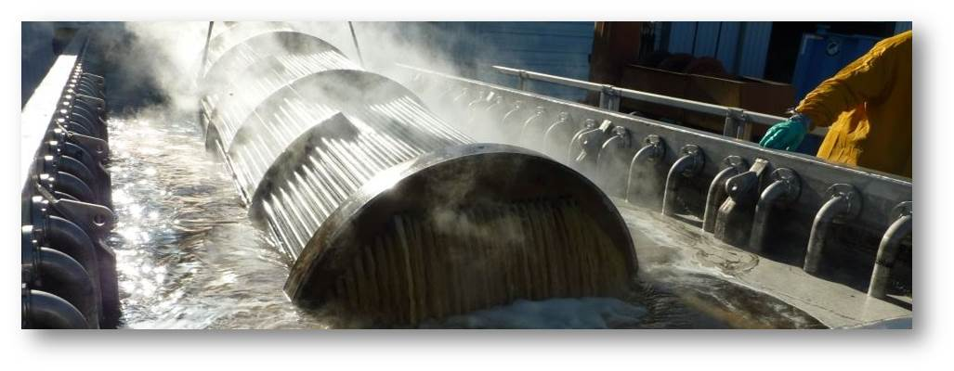
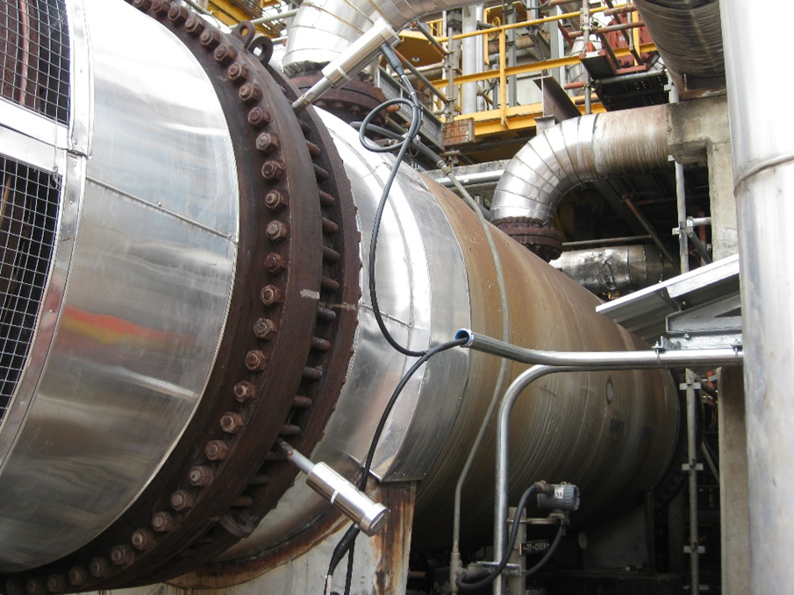
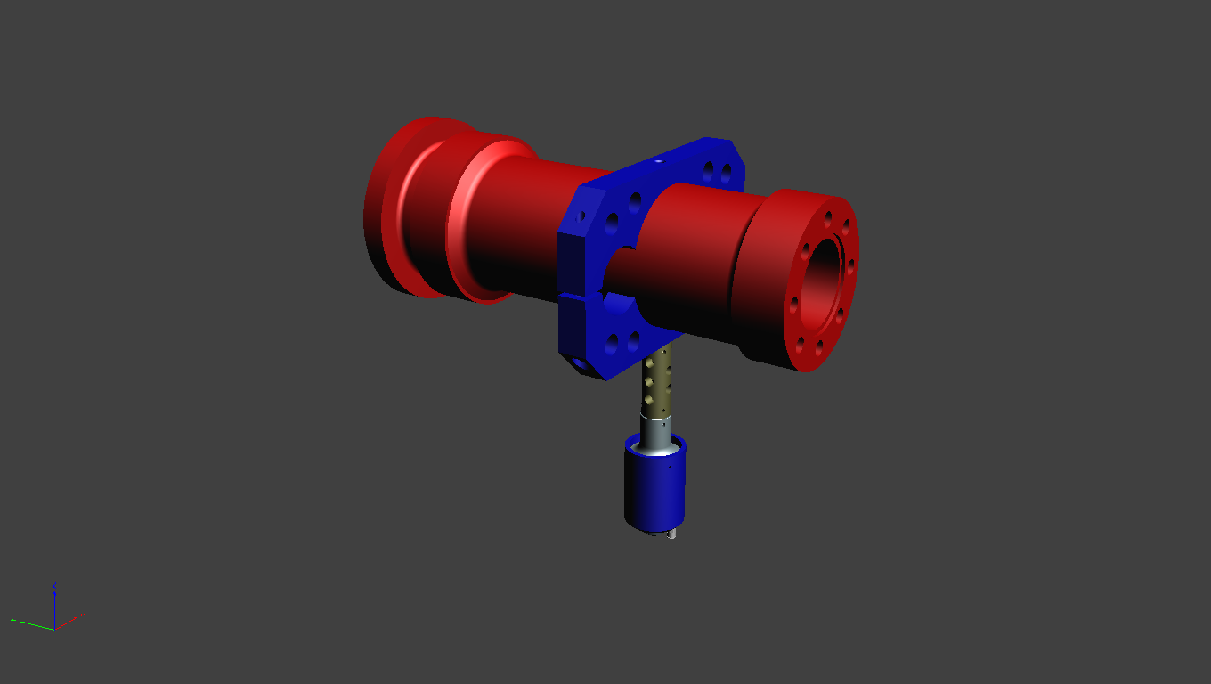
Ultrasonic Cleaning Baths
Multiple sizes & configurations
Variable powered units for purpose-built cleaning applications
Clean-in-Process Technologies
  USP [Ultrasonic Scale Prevention]
  M³ Technology
Fouling Mitigation & Process Improvement
  M³ Technology (clamp on) apparatus with pre-selected ultrasonic power output, to match with specified outcomes
  Ultrasonic Pigging Train
Notes:
We specialize in the engineering of Purpose build ultrasonic equipment for both offline cleaning and online fouling mitigation purposes in process dependent industries.
Our focus is primarily Ultrasonically based solution sets. My experience in this space has come from my time as the Director for Global business development for Tech Sonic Services.
They were the originator of ultrasonic cleaning tanks for heat exchangers the North American market place.
I was with them from 2009 to 2013.
As I travelled the world educating audiences on the many benefits of associated with immersion based ultrasonic cleaning for heat transfer assets it became evident that the needs and desires for fouling mitigation solutions beyond many of the current offline cleaning tech’s was in fairly heavy demand.

Slide 3
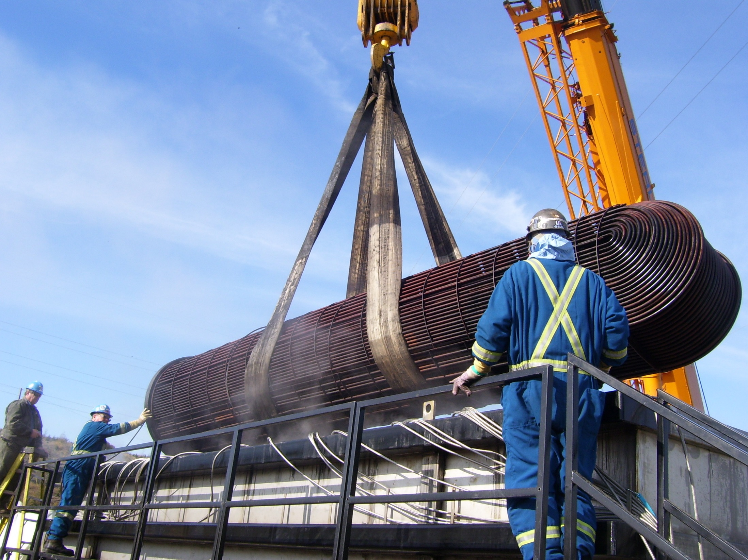
The very first heat exchanger was cleaned by ultrasonic bath in November 2009, Fort McMurray, Alberta Canada
SUNCOR
Notes:
The inception of ultrasonic immersion cleaning for shell and tube heat exchangers, was in November of 2009. I cleaned this heavily fouled, bitumen bundle for Suncor Energy, Fort McMurray Alberta, Canada. The success of this early trial led to the introduction of immersion cleaning at multiple Shell Oil sites in Canada.

Slide 4
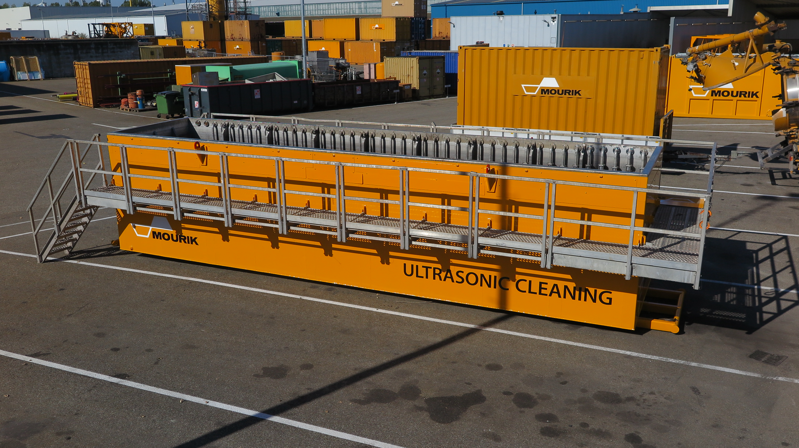
10m Ultrasonic Bath 2016
Notes:
By 2012, the first European vessels had found a home with Mourik Services in Rotterdam, for specific contract work with Shell Moerdijk and Pernis

Slide 5
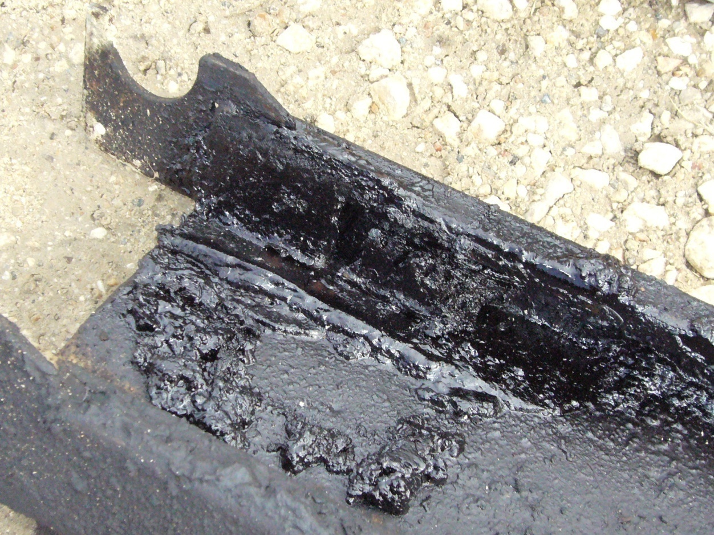

Before heat exchangers, we cleaned scaffolding.
Typically, the refinery would give us something that looked like this…

Slide 6
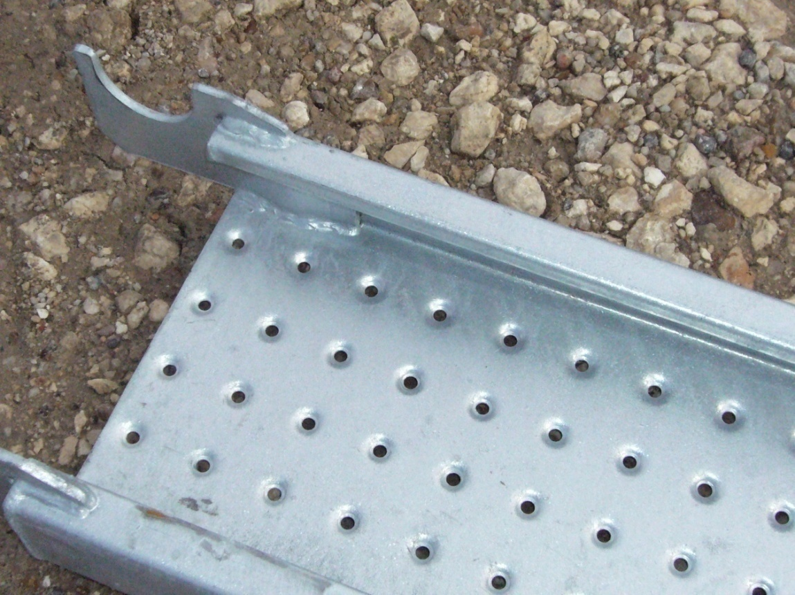
… and we would give them back a plank like this in about 25 minutes

Slide 7
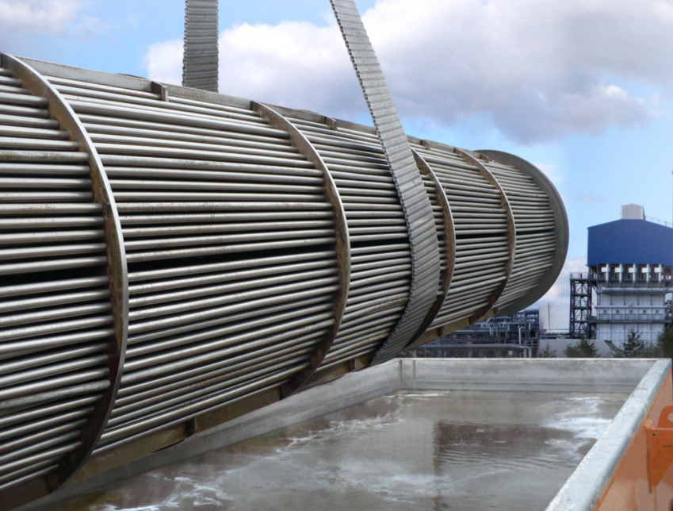
Acoustic Cleaning Baths
Will accommodate Hx units up to 8m in length
Axle allows for easy transport and set-up without needing a crane.
Essential Wave Technology (EWT). Purpose built ultrasonic generators and transducers to work in extreme conditions and temperatures.
Model: 2764AXL
Notes:
Like many things technology evolves.
ORANGE engineered designs are more energy efficient than previous TS designs, using a different types and frequencies of ultrasonic(US) transducers and generators. They are more robust and can truly stand up to site work
Ease of mobility to/from and while at site.
Some units are equipped with specialized pumps that circulate tank liquid on an interval basis (promotes internal rinse)
Uses less than 50% chemistry of conventional tanks, which equates to a less expensive cleaning project, compared to competitive models in operation.
Currently, Mourik Services will have two to three of these units in operation at any given point in time.

Slide 8
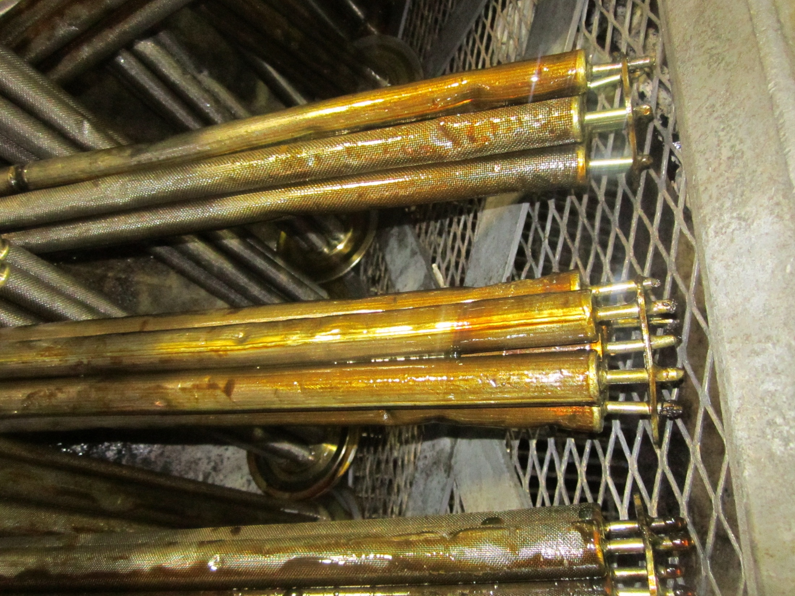
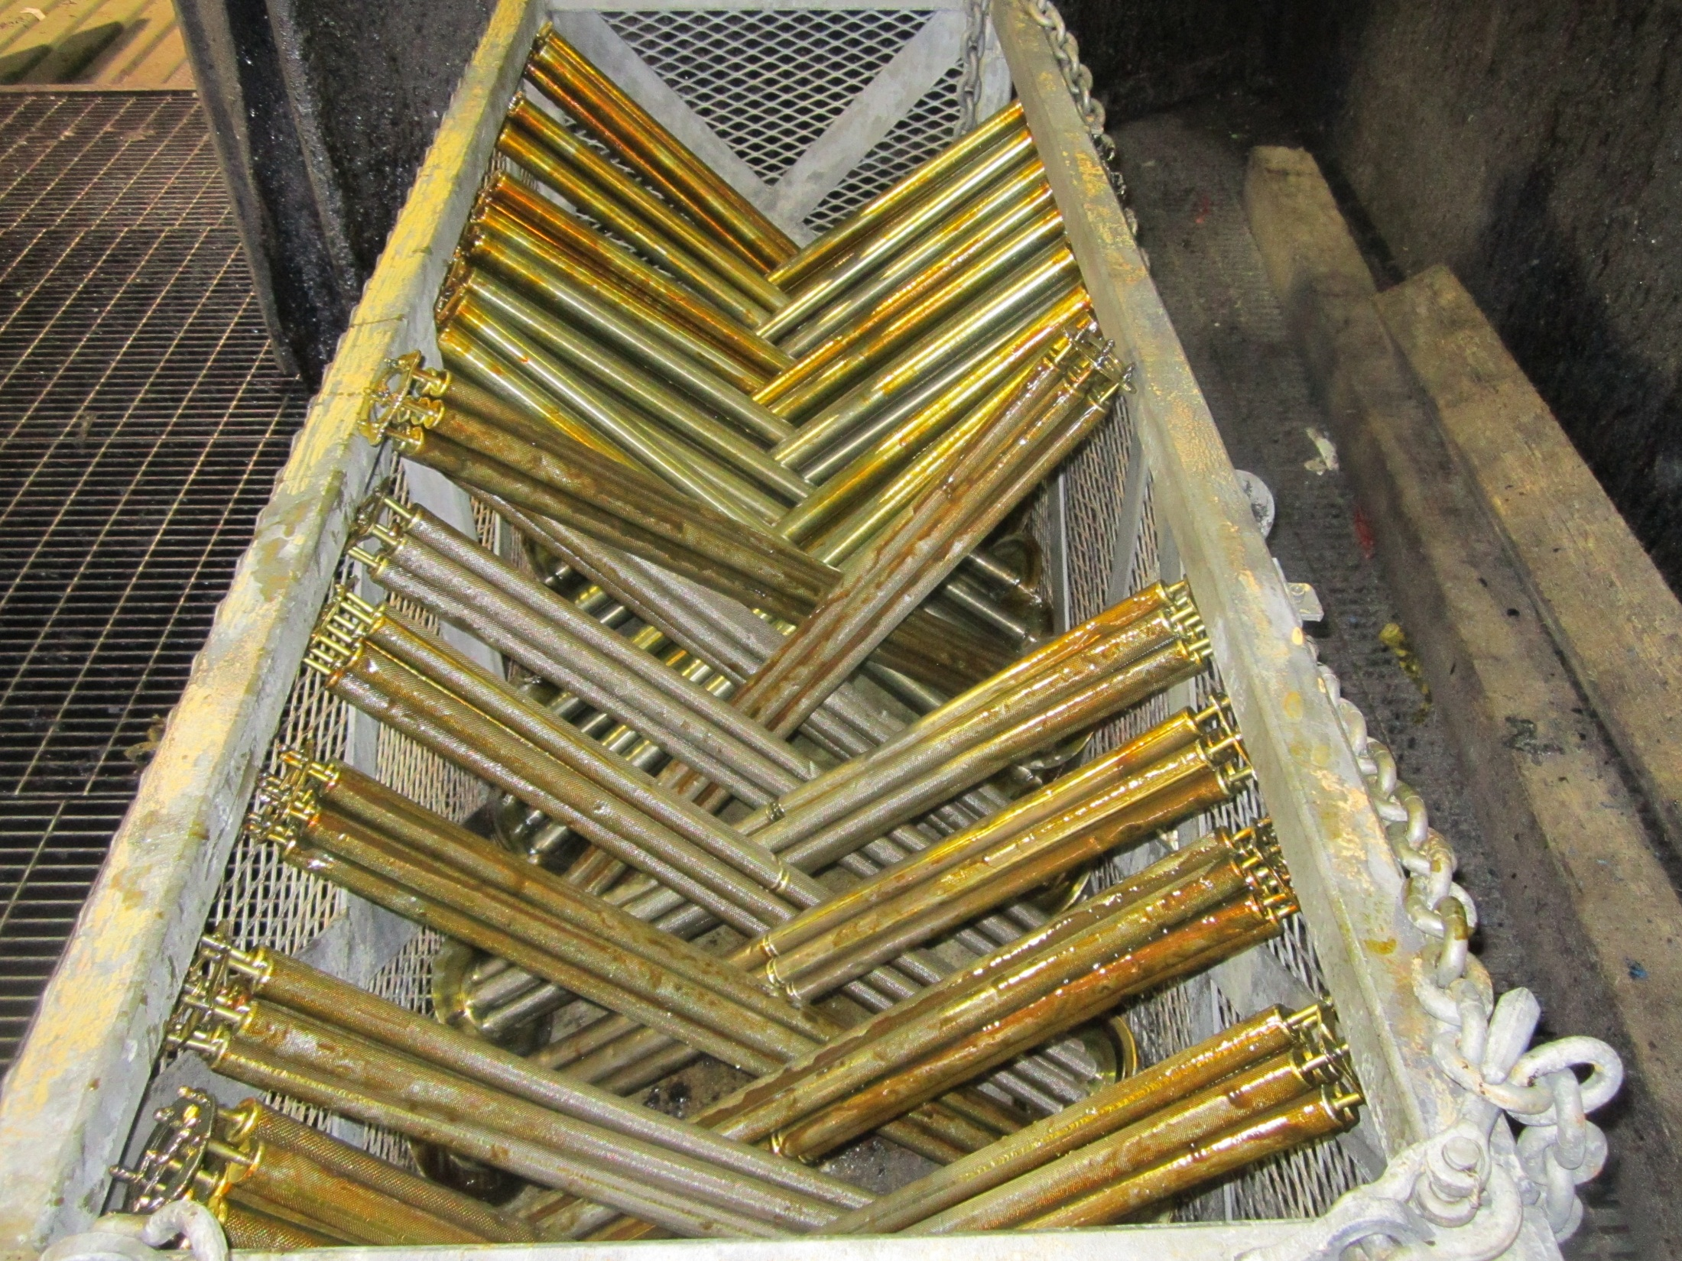
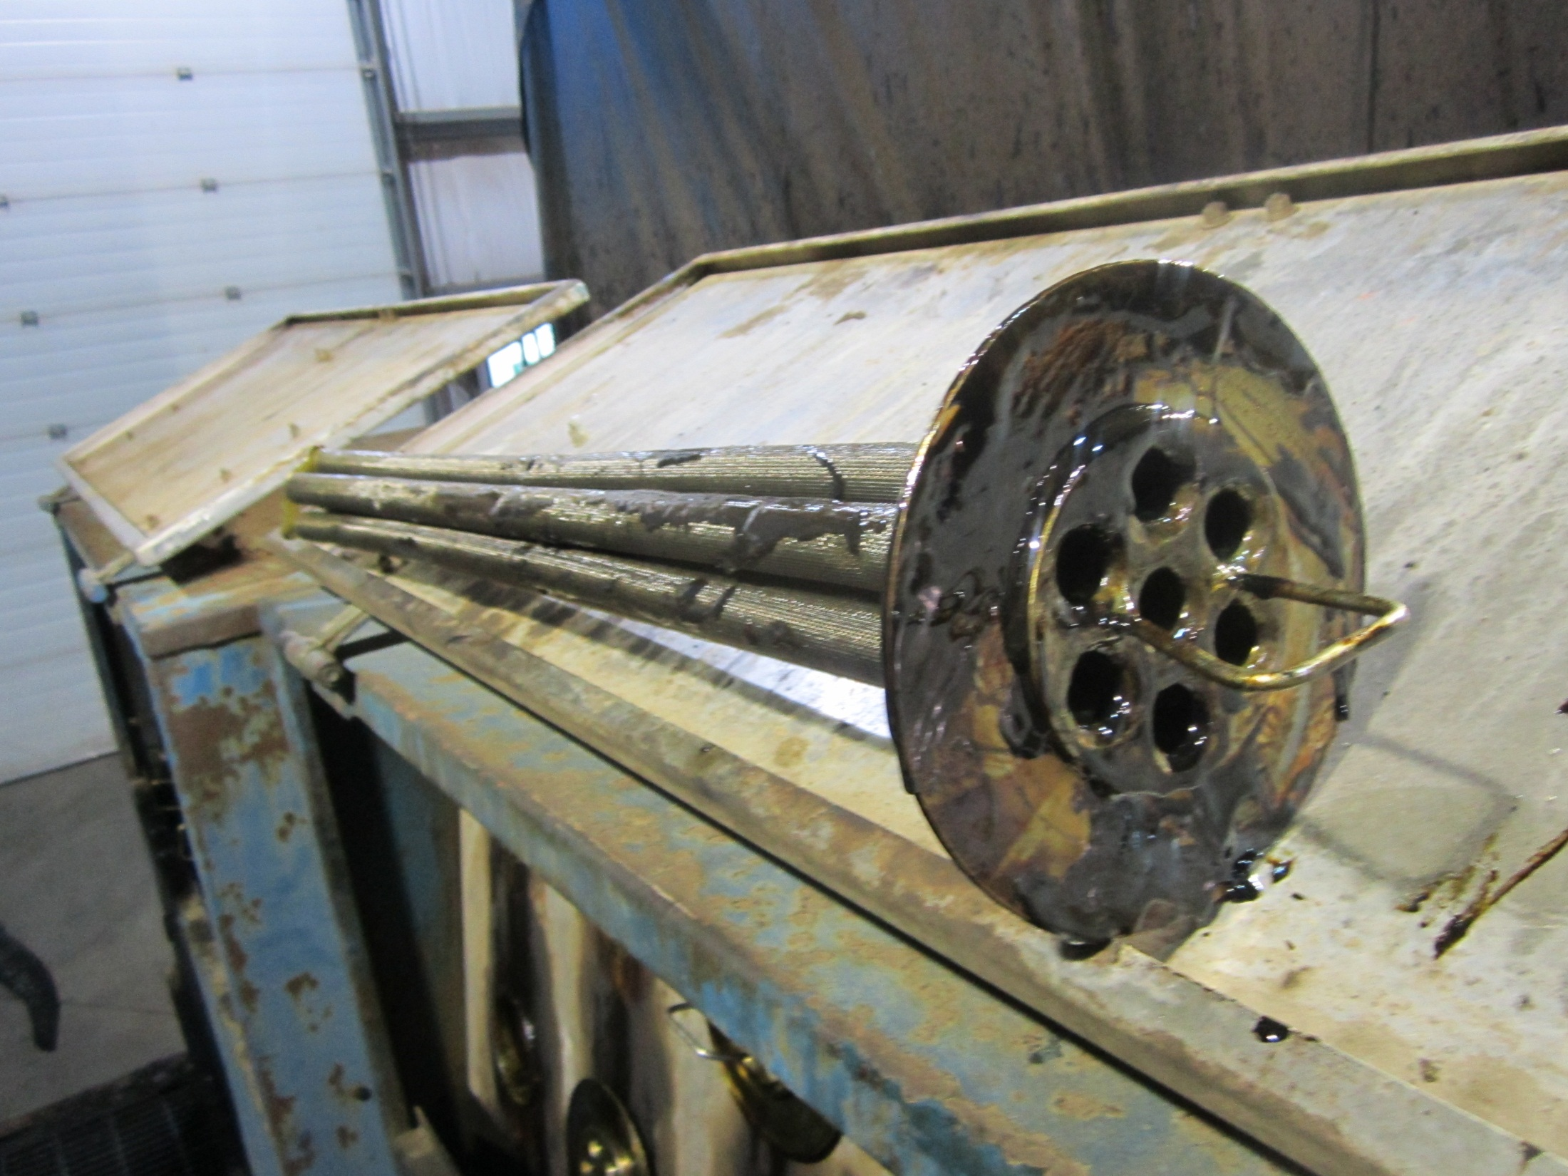
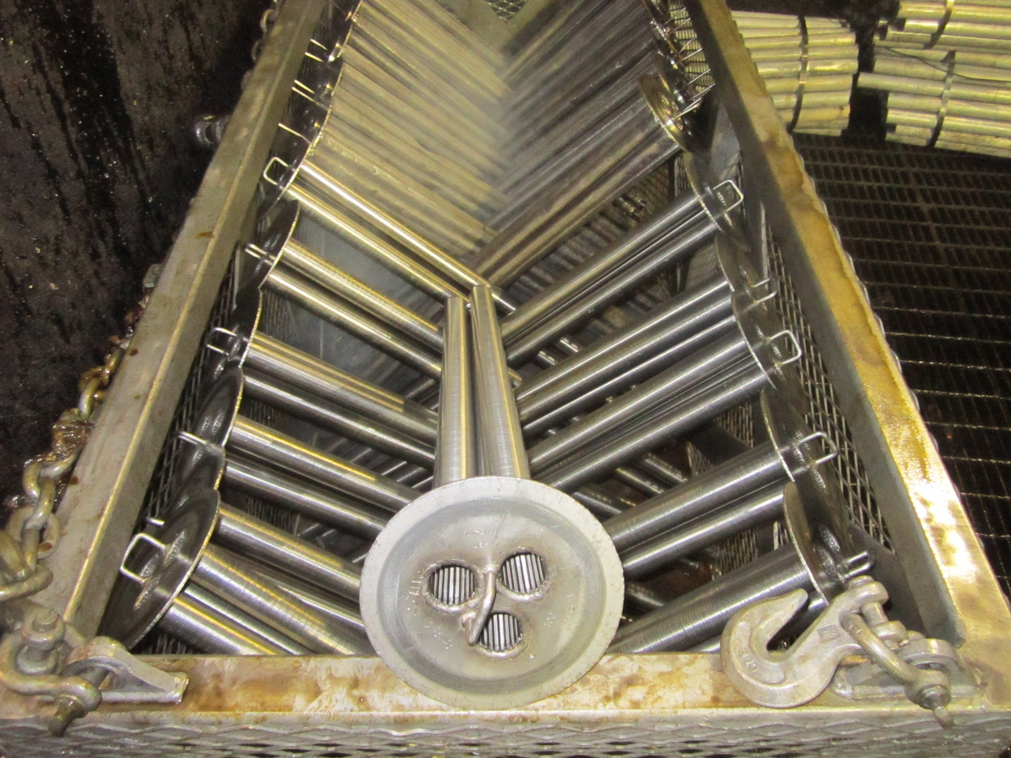
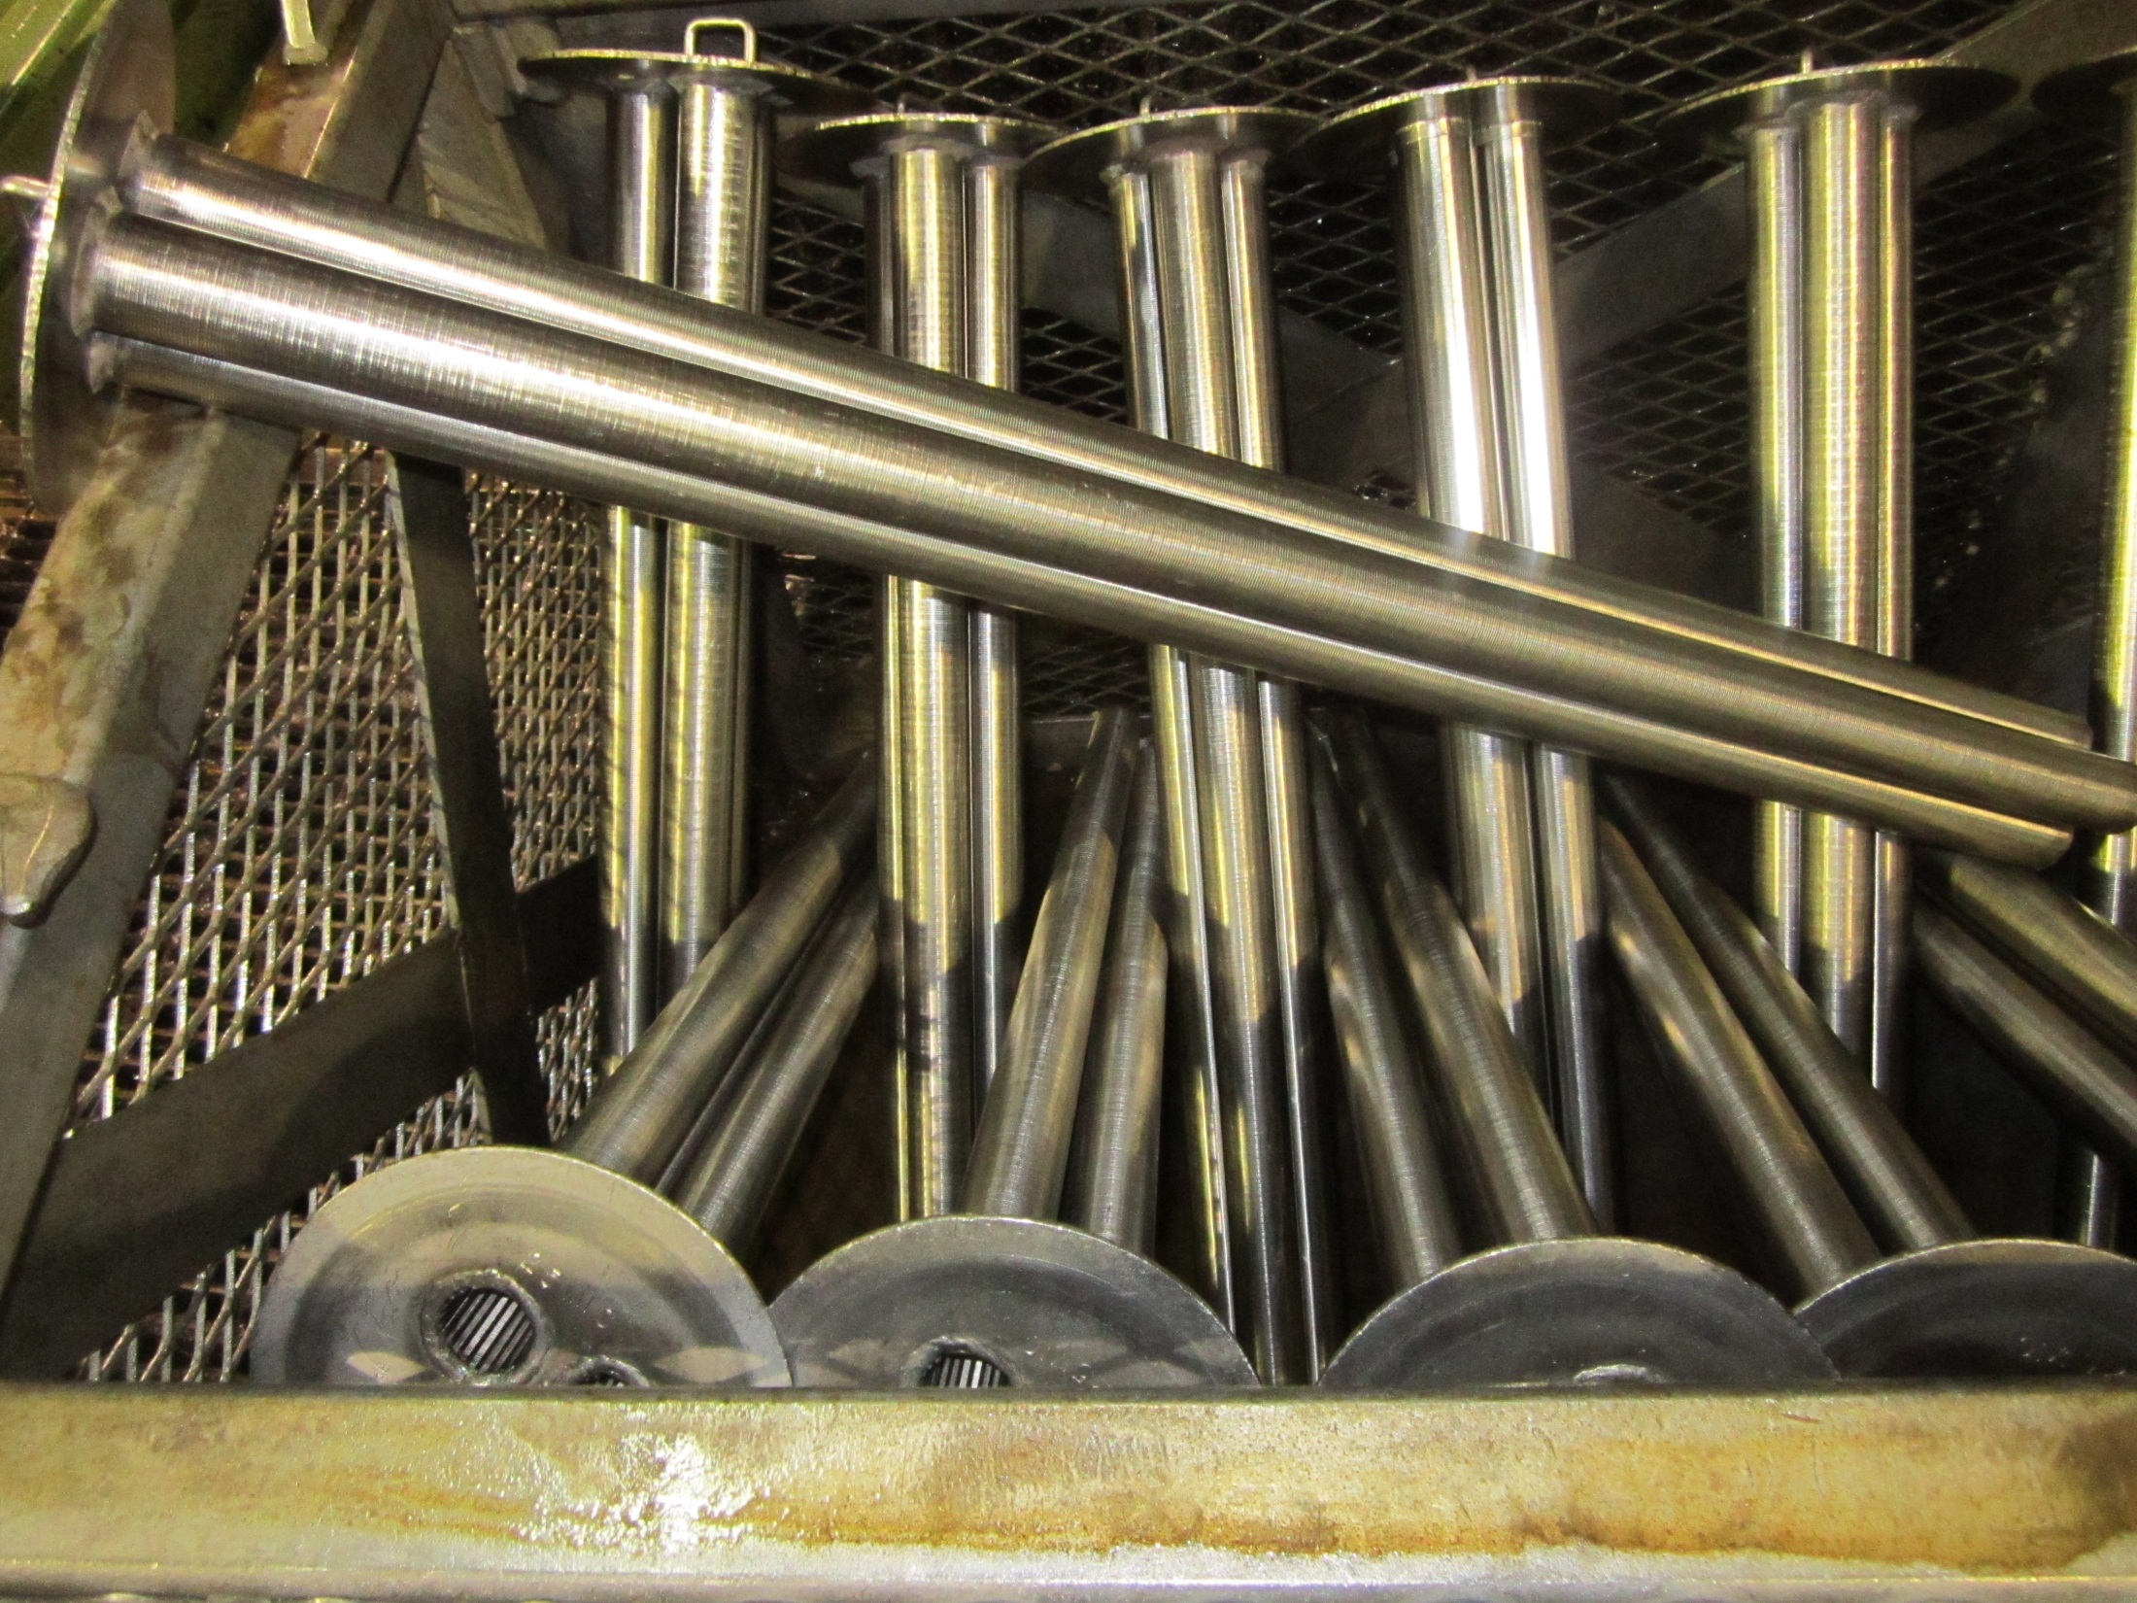
Sintered Metal filters cleaned in batches
Previous cleaning with high pressure water or agressive chemicals were damanging these filters.

Slide 9
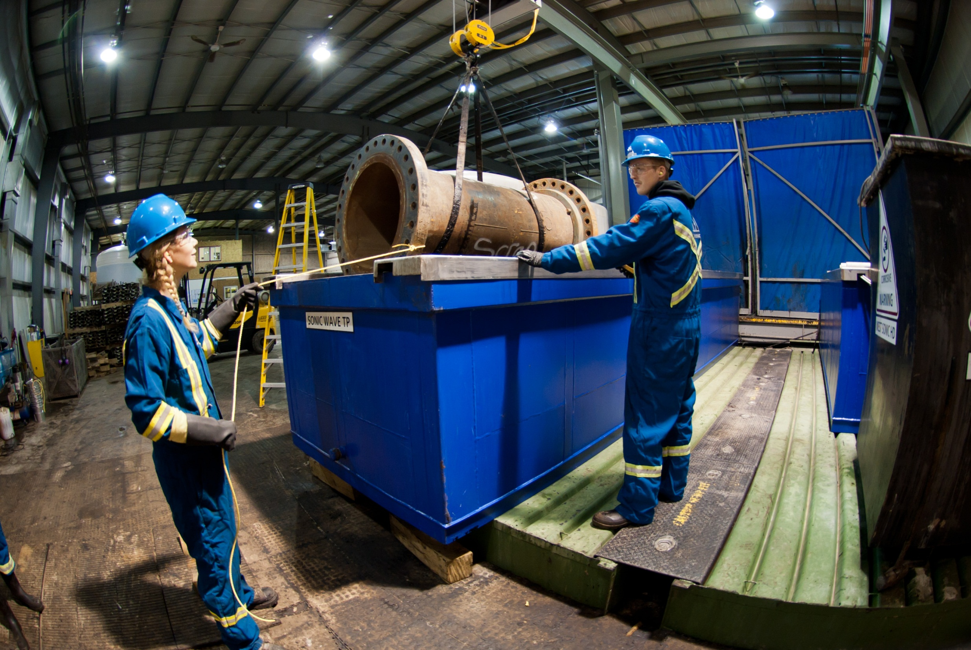
32ft. Heat Exchanger Cleaning Vessel,

Slide 10
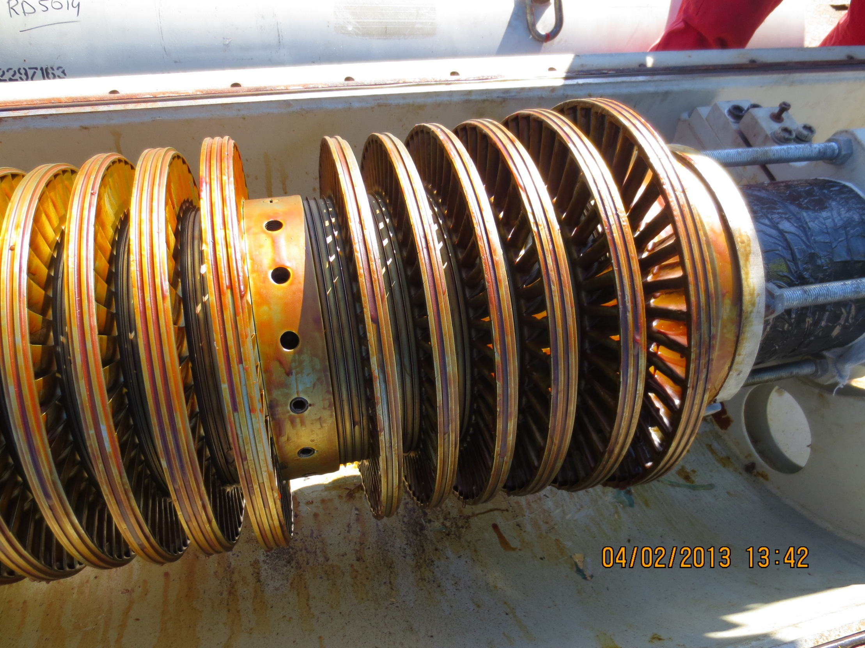
Rotor: SHELL, Rheinland, Raffinerie

Slide 11
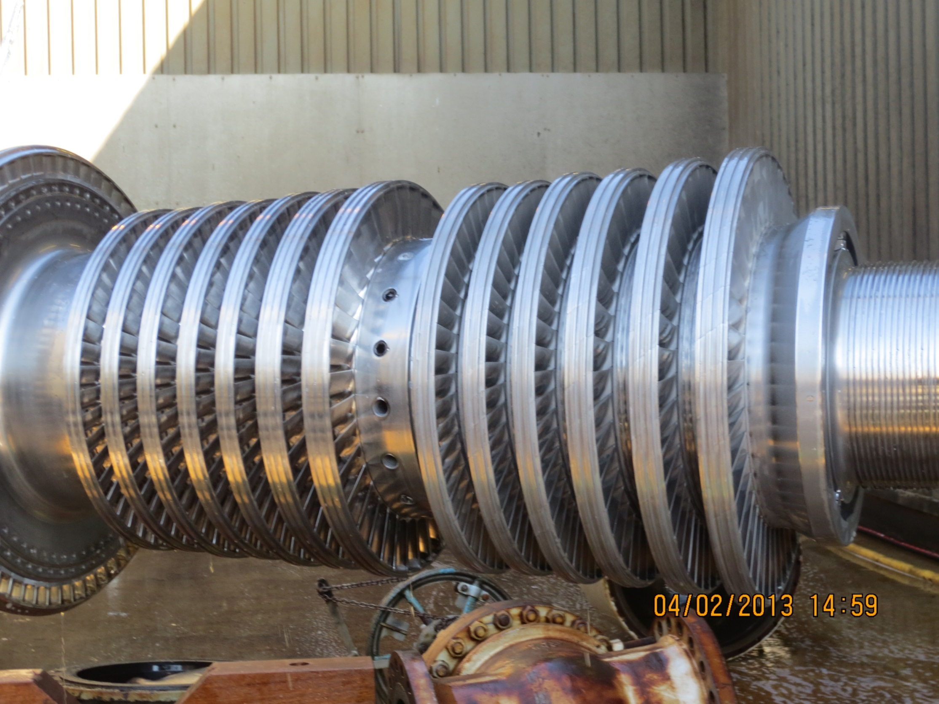
Rotor: SHELL, Rheinland Raffinerie
Note the cleaning time!

Slide 12
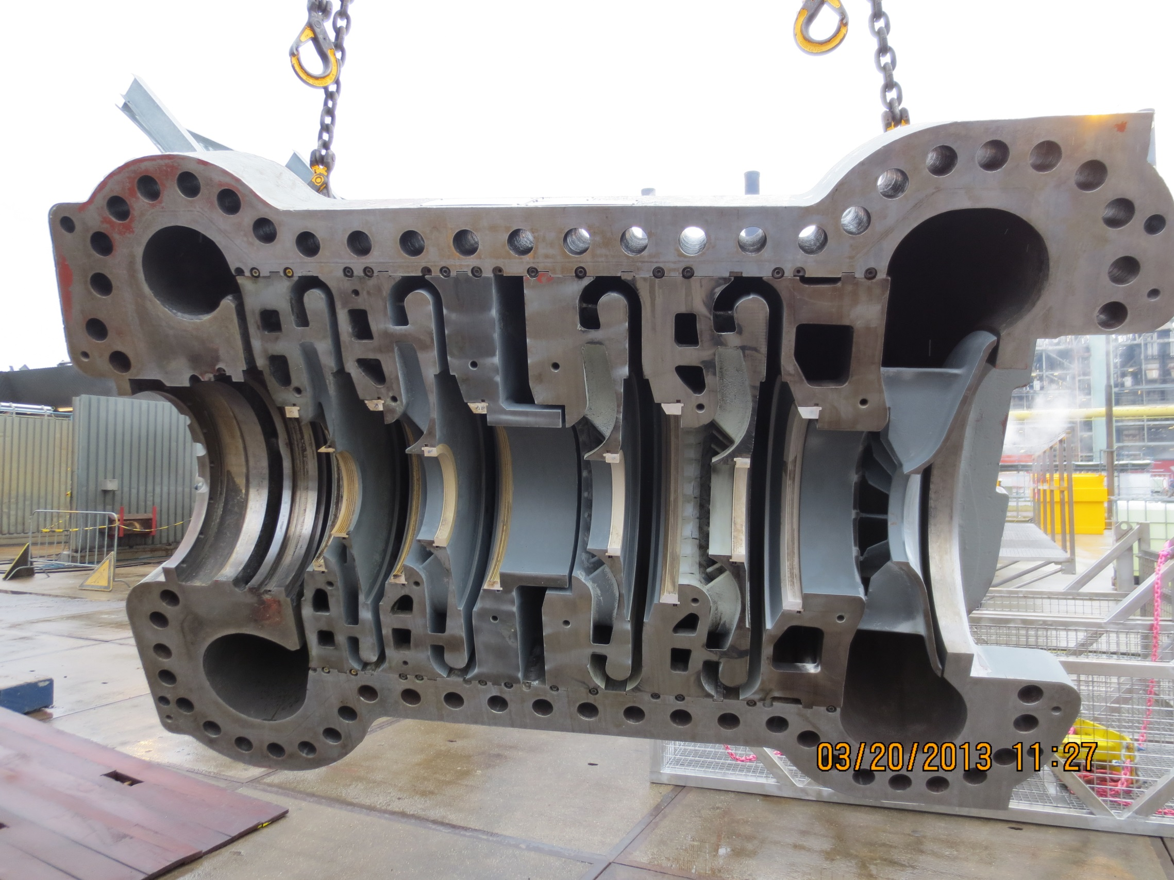
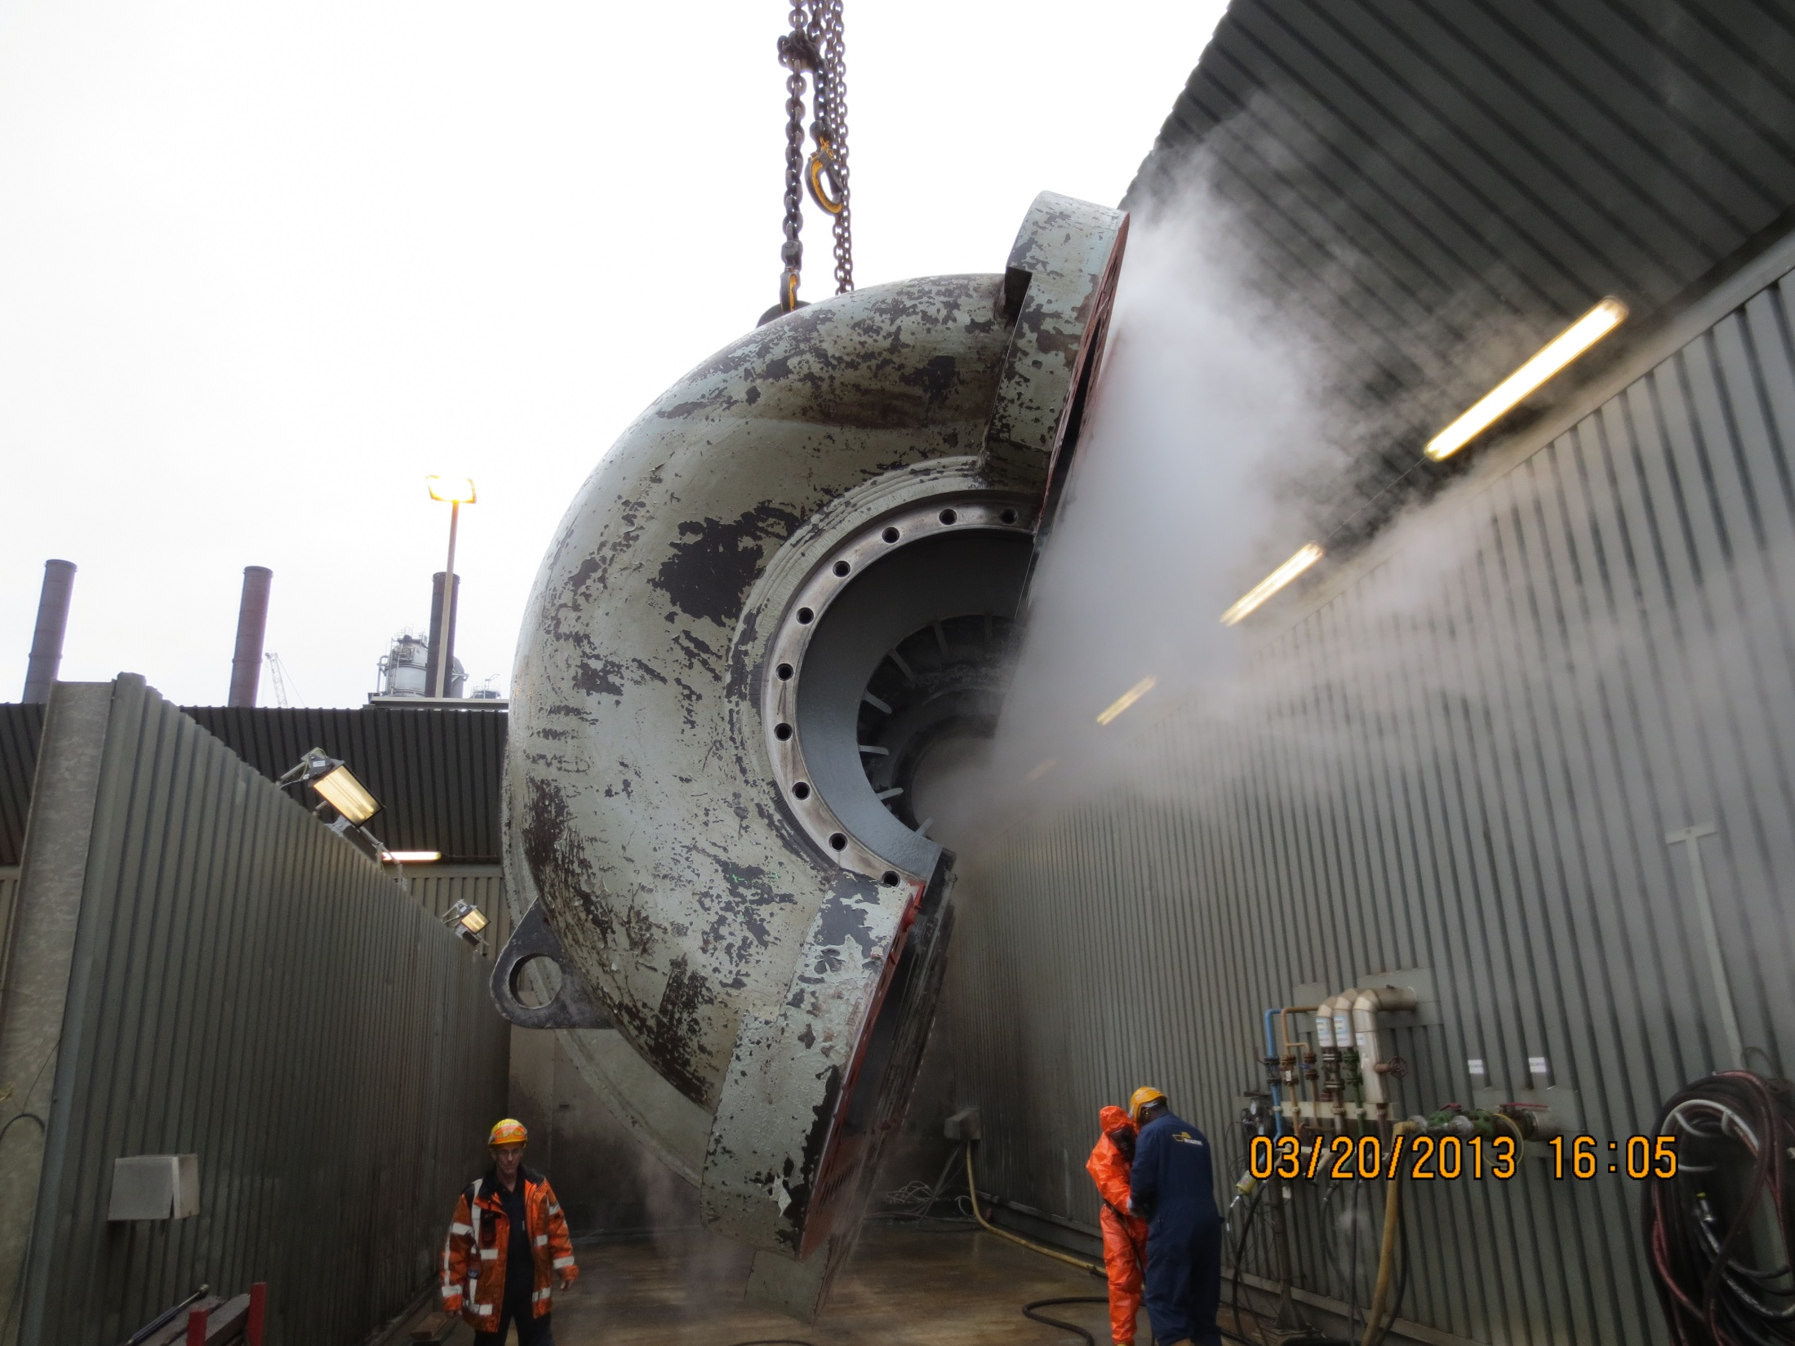
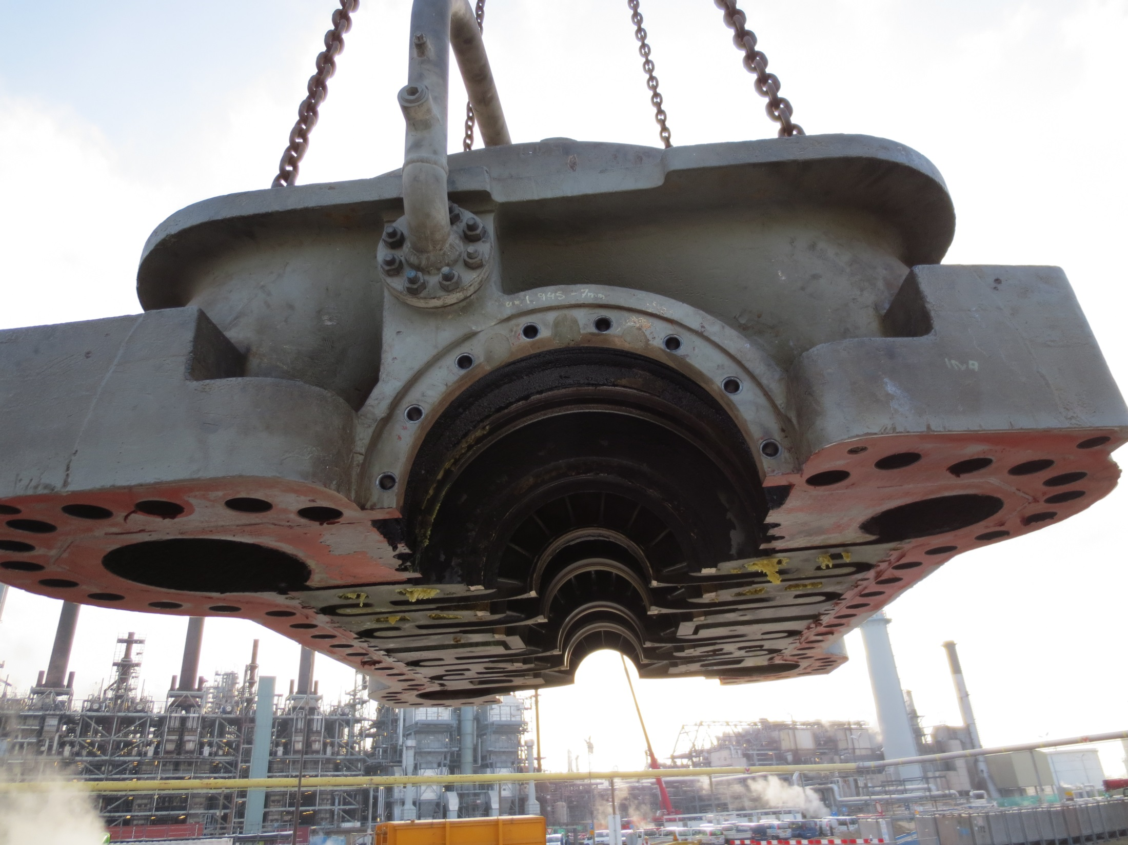
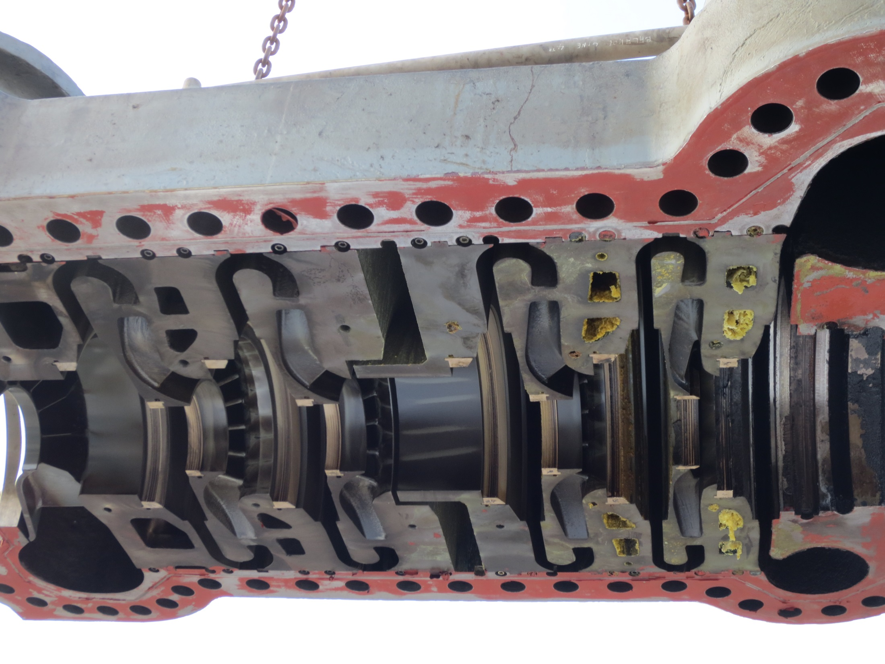

Slide 13
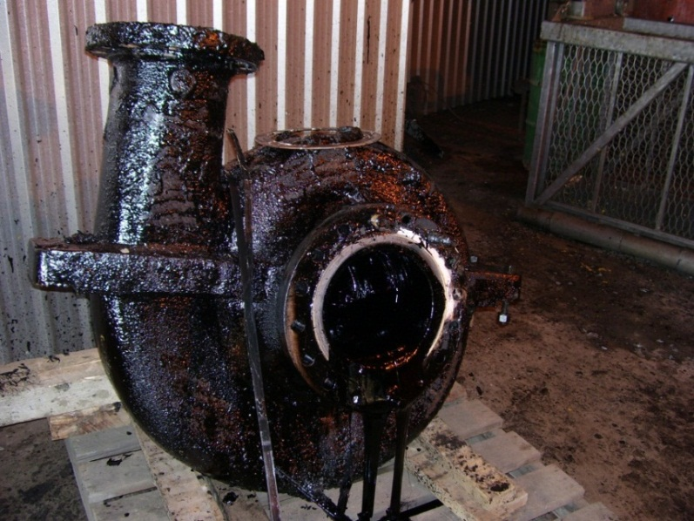
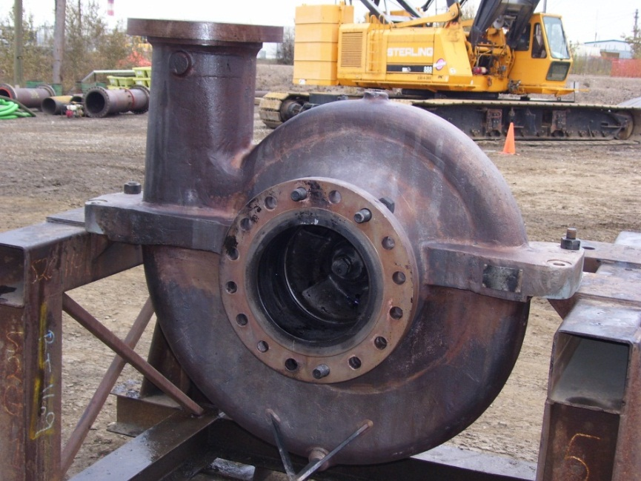
What Can You Clean ?
Scaffolding
Pumps
Valves
Spools
Barrels
Elbows
Pipe
Nozzles
Filters – every kind including DPF’s
Tools
Exchangers

Slide 14
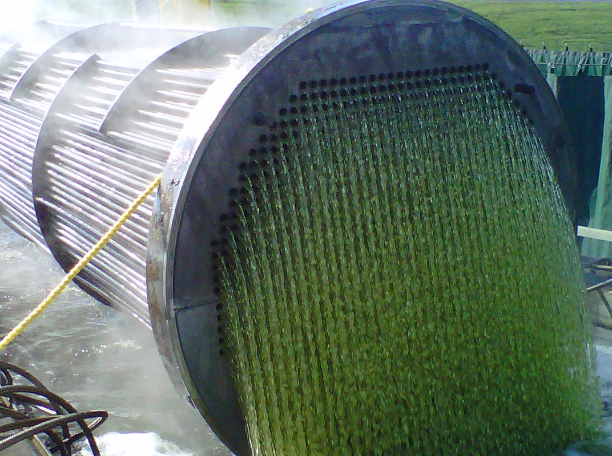
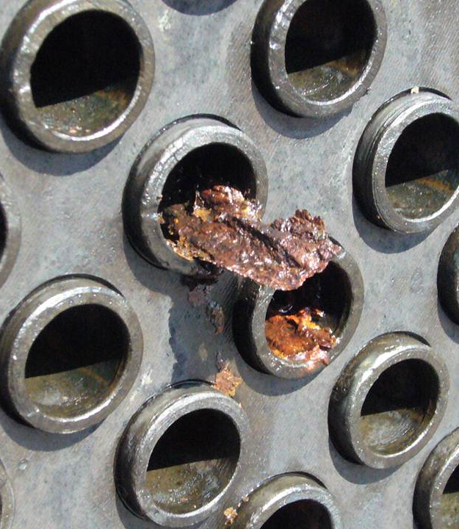
THE CLEANING PROCESS:
How does it work?
Other types of deposits remain,
but no longer adhere to the
tubes.
The process removes contamination in one of two ways, and depends on the type of fouling deposits being removed.
Some deposits are dissolved into solution…

Slide 15
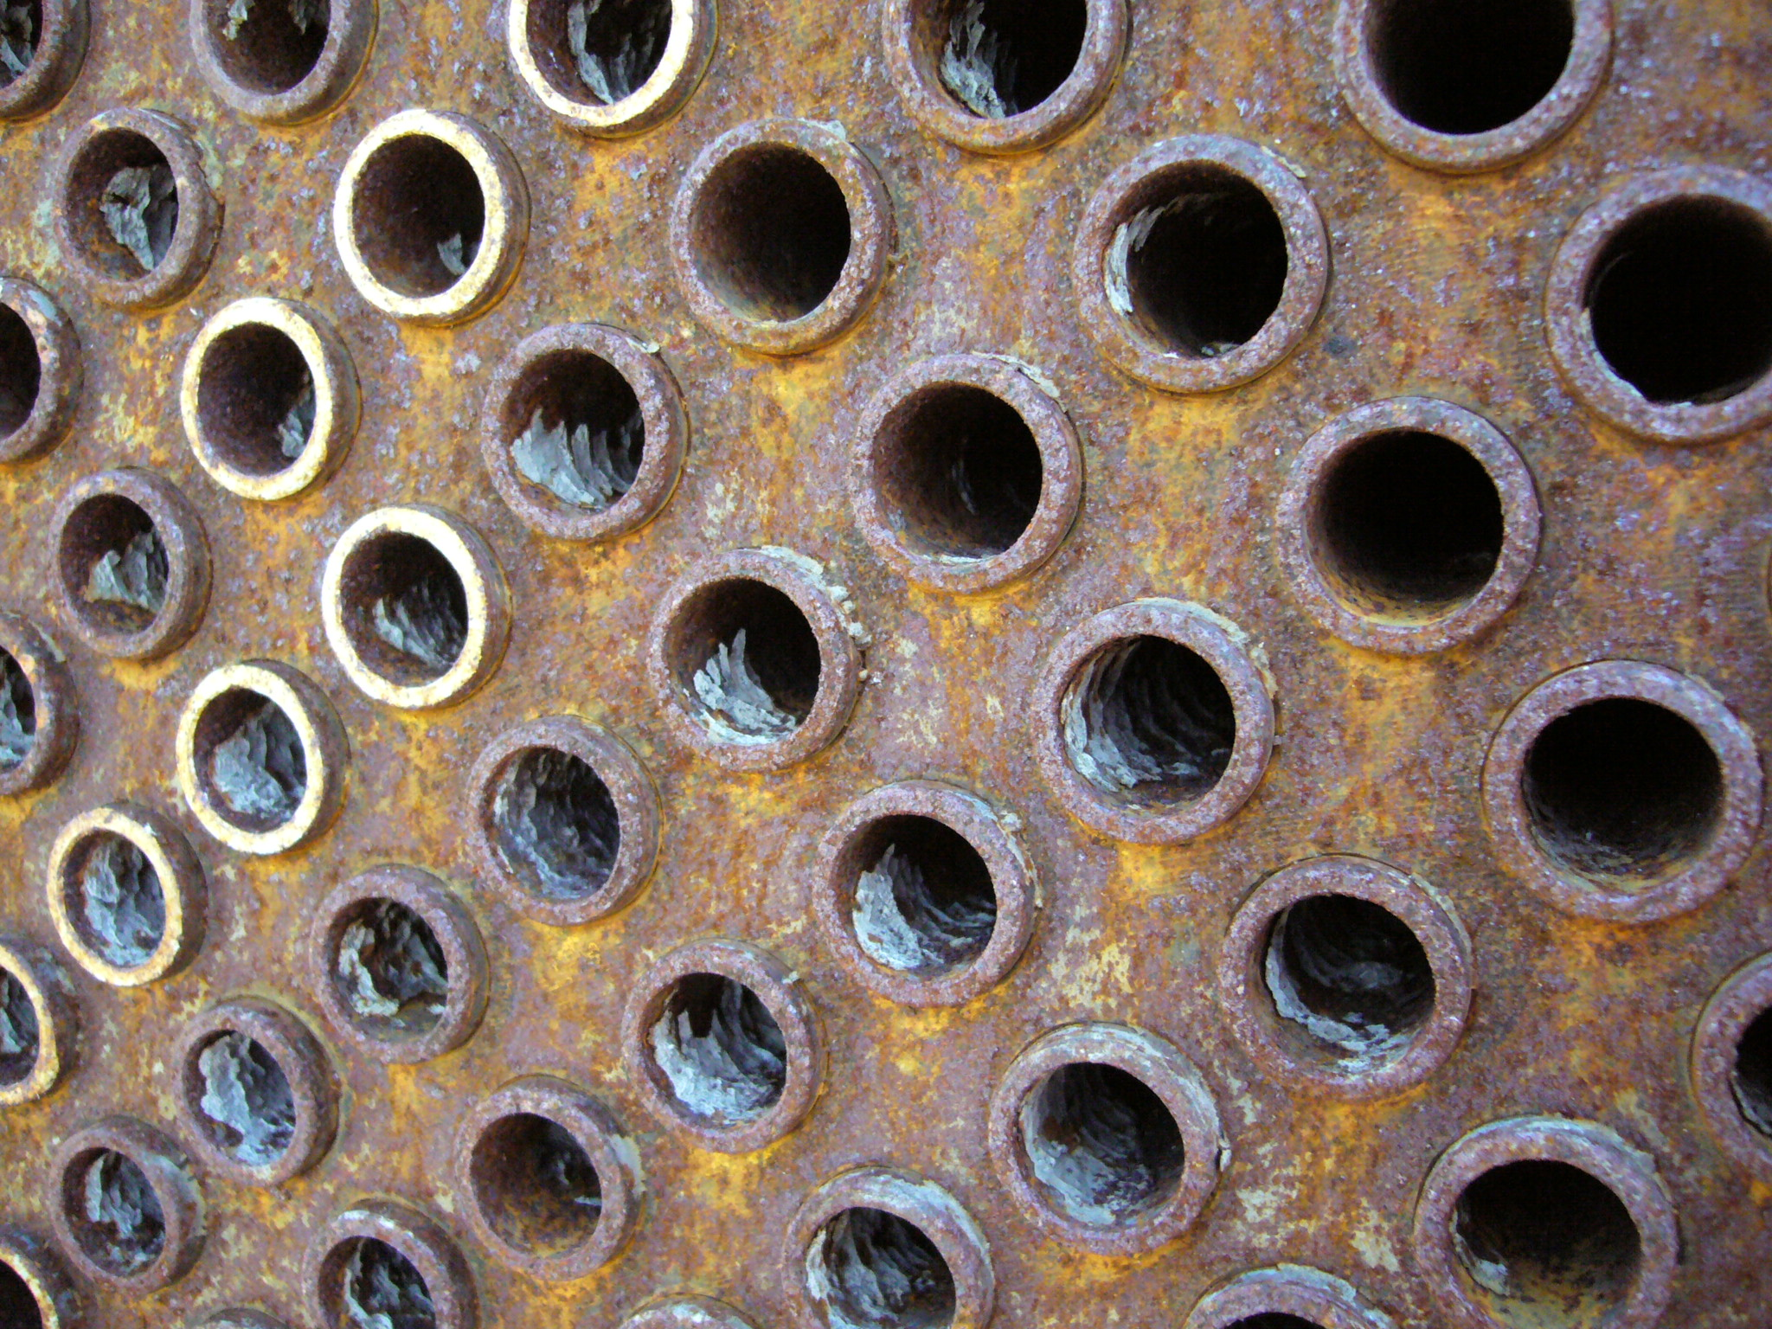
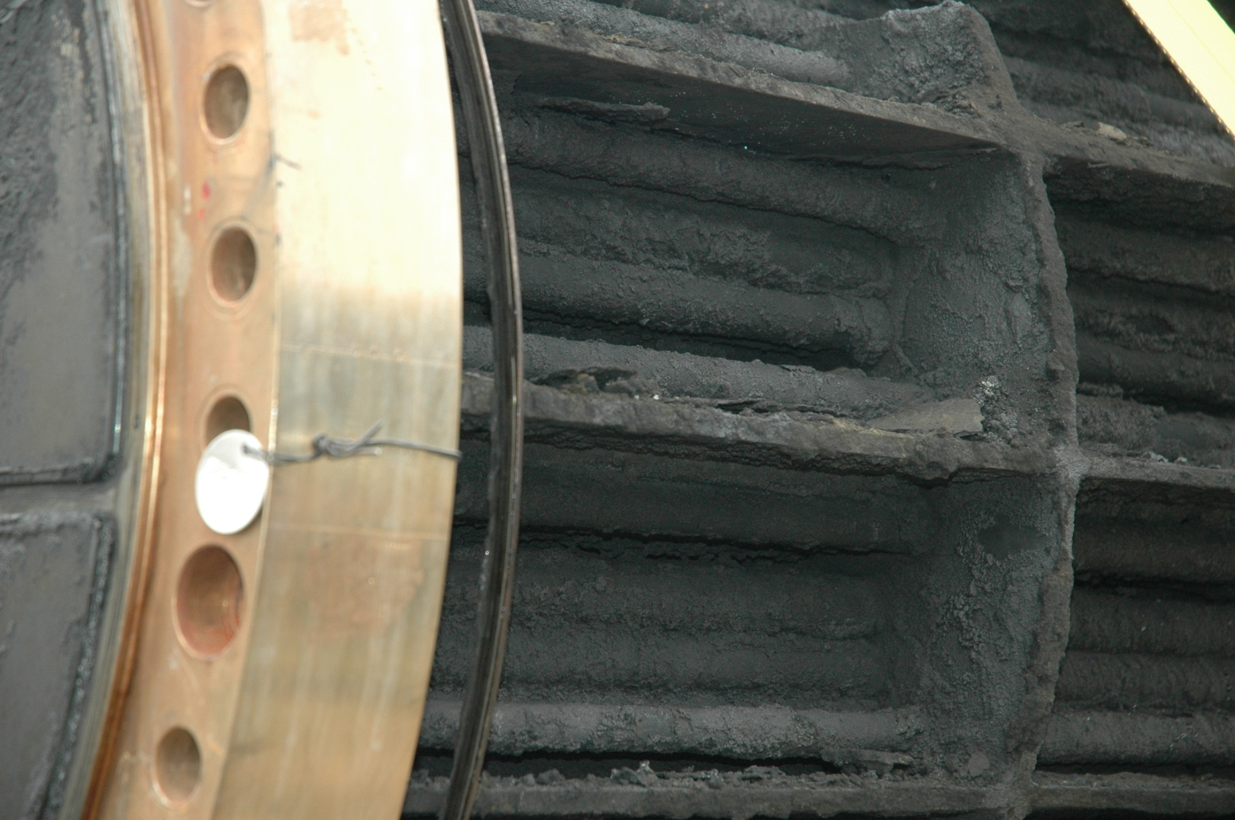
This heat exchanger bundle had too many perforated tubes and was being sent for scrap.
The bundle would need to be cleaned with high pressure water and inspected before removal from site

Slide 16
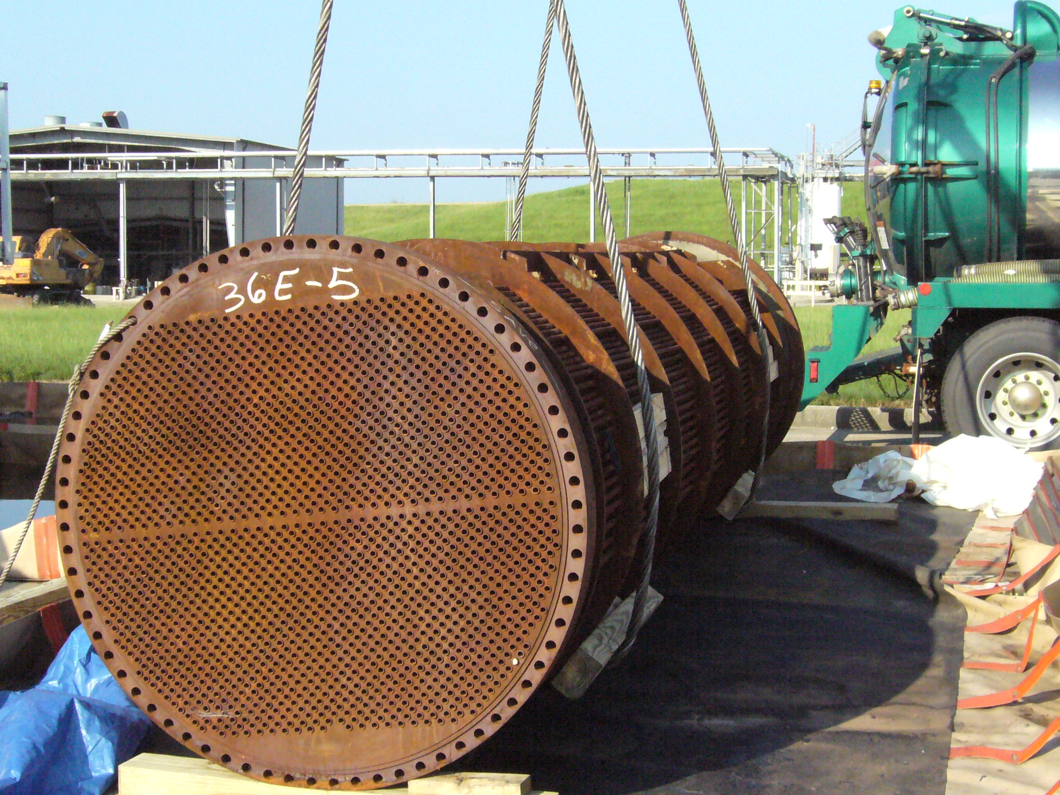
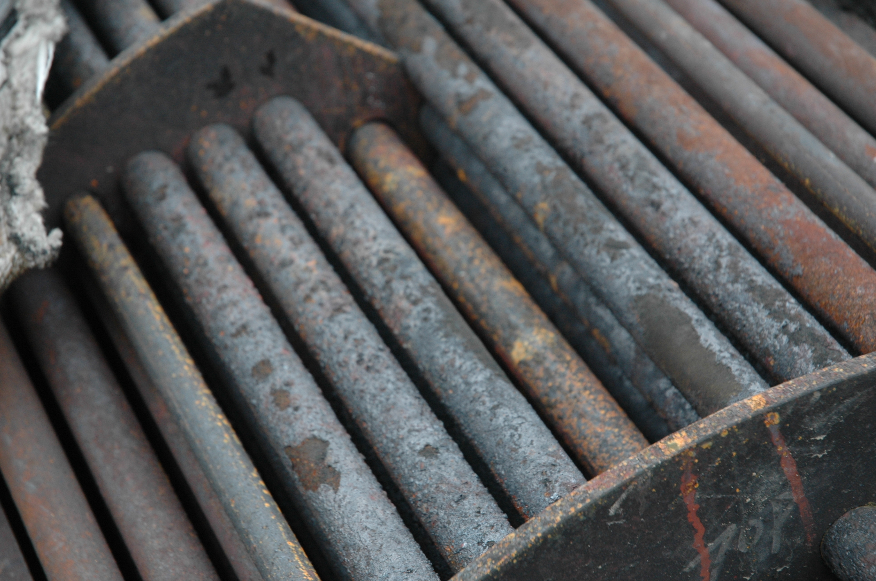
The bundle was cleaned with high pressure water and inspected before removal from site.

Slide 17
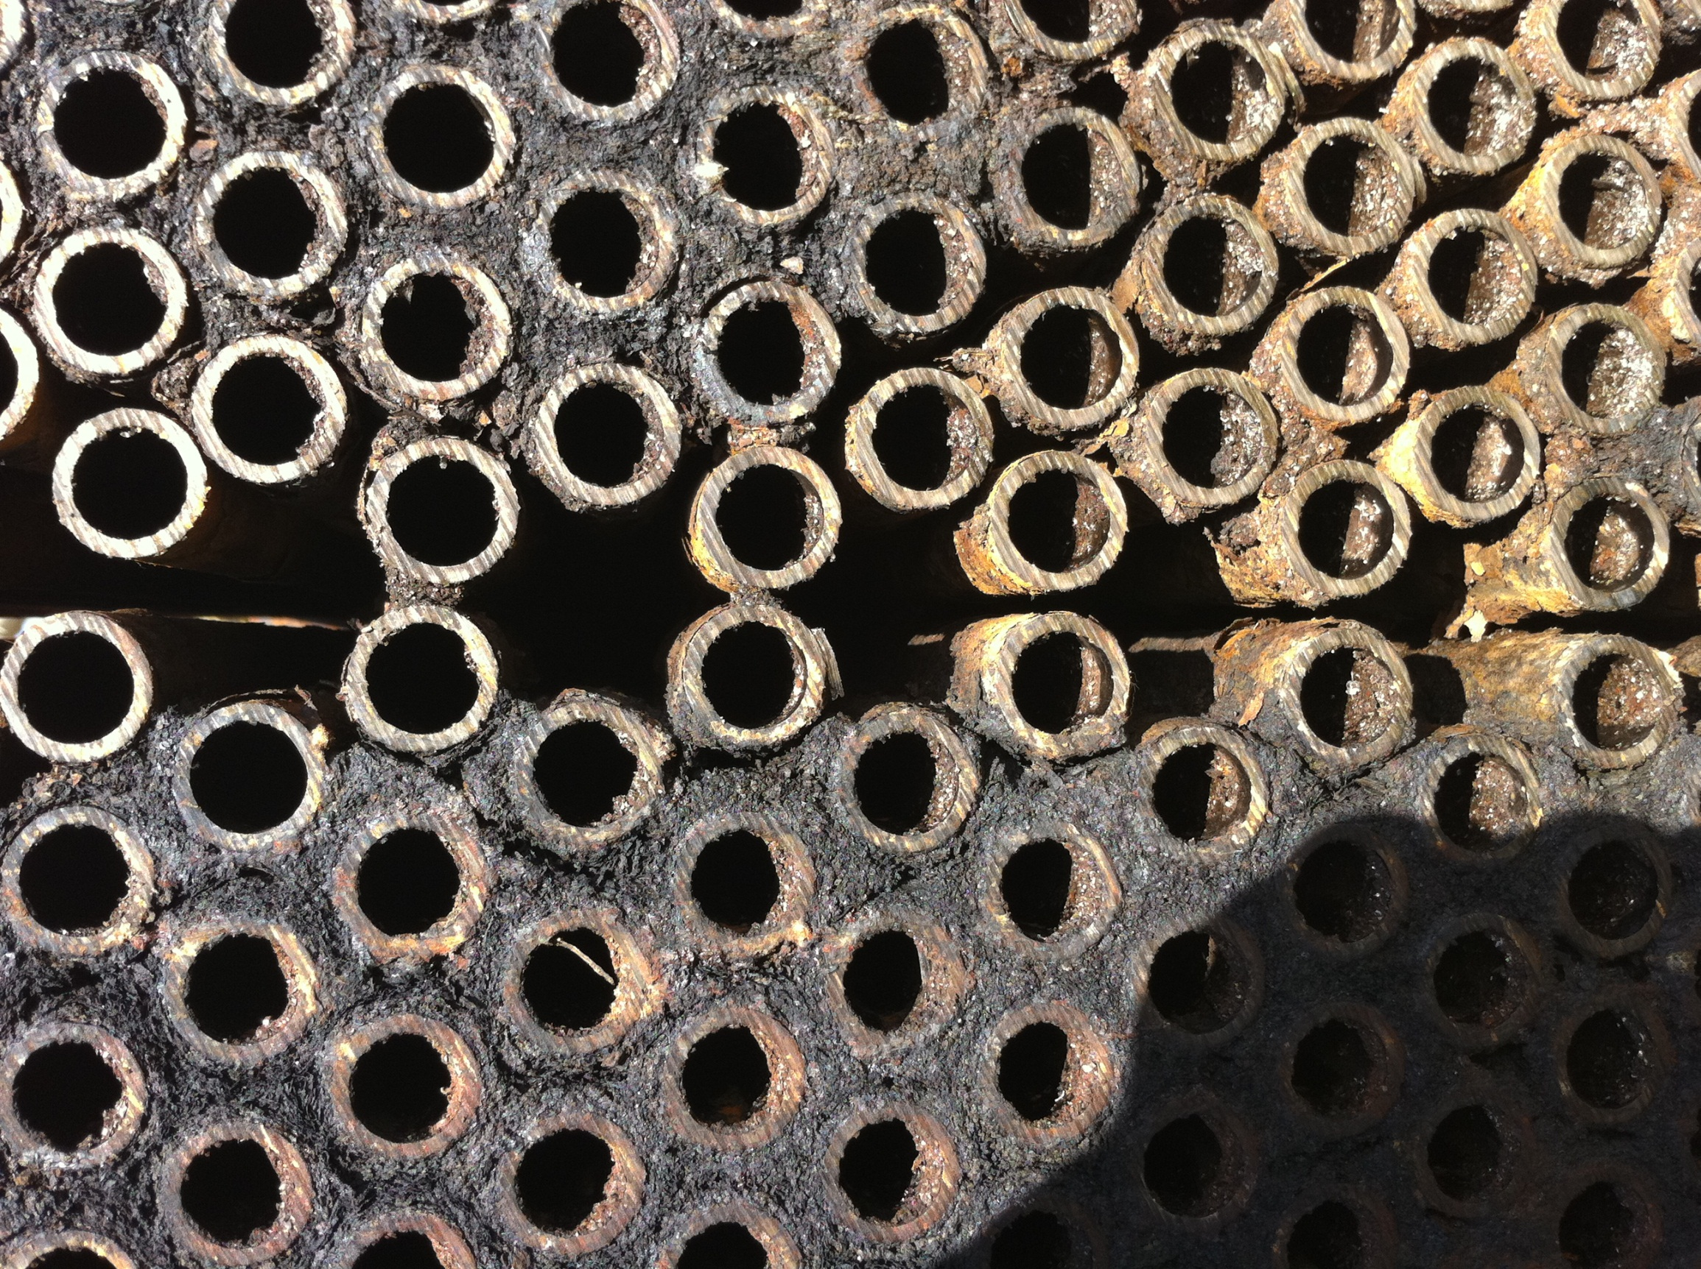
Suspecting the shell side of the bundle could not be cleaned effectively with hydro blasting alone, we cut the tubesheet off.
With the tubesheet off, it was clear that there is much fouling left between the tubes.

Slide 18
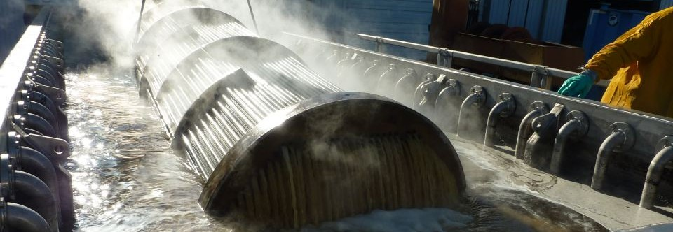
The very nature of this submersion technology allows the sound wave cleaning to reach and remove contamination from those hidden areas that other methods simply cannot.

Slide 19

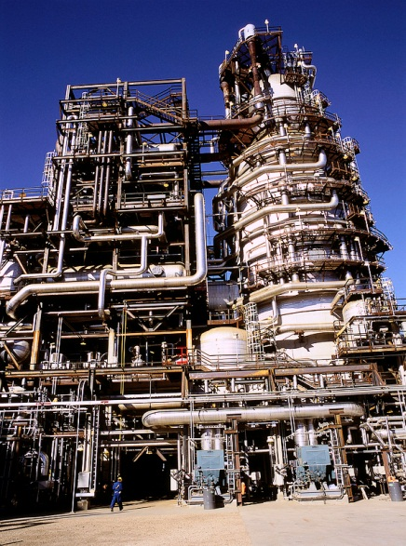

The Shell Scotford Upgrader
Fort Saskatchewan, Alberta

Slide 20
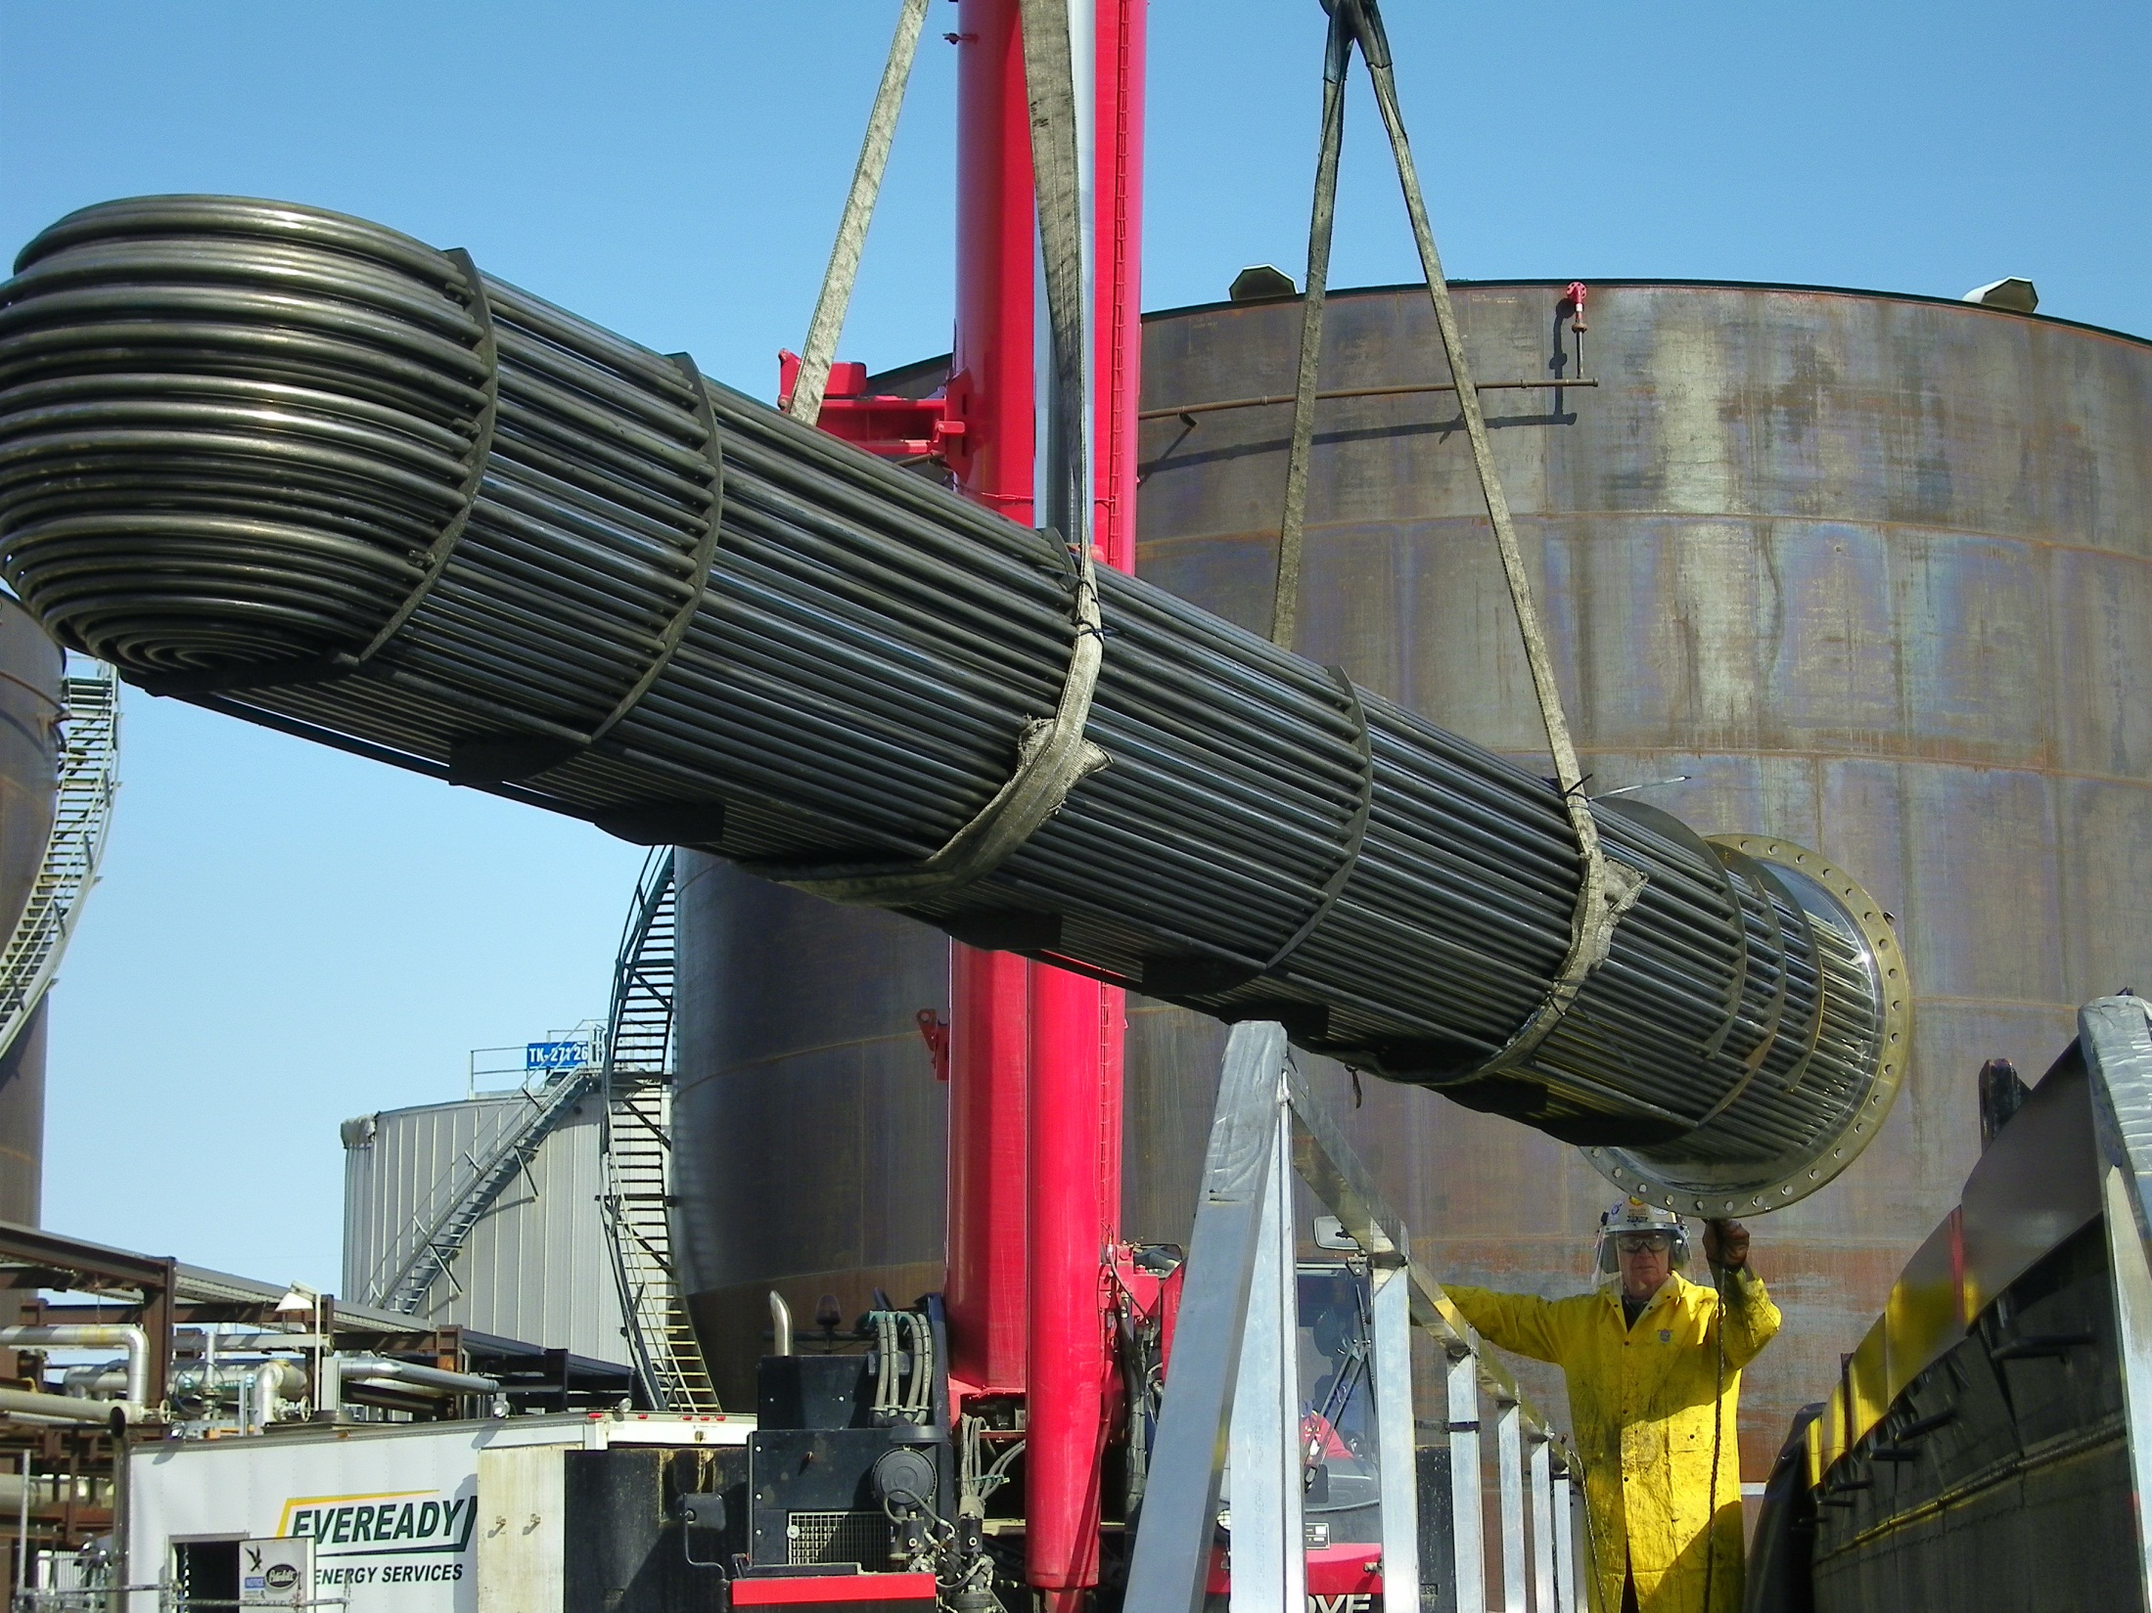
Shell Scotford Upgrader

Slide 21
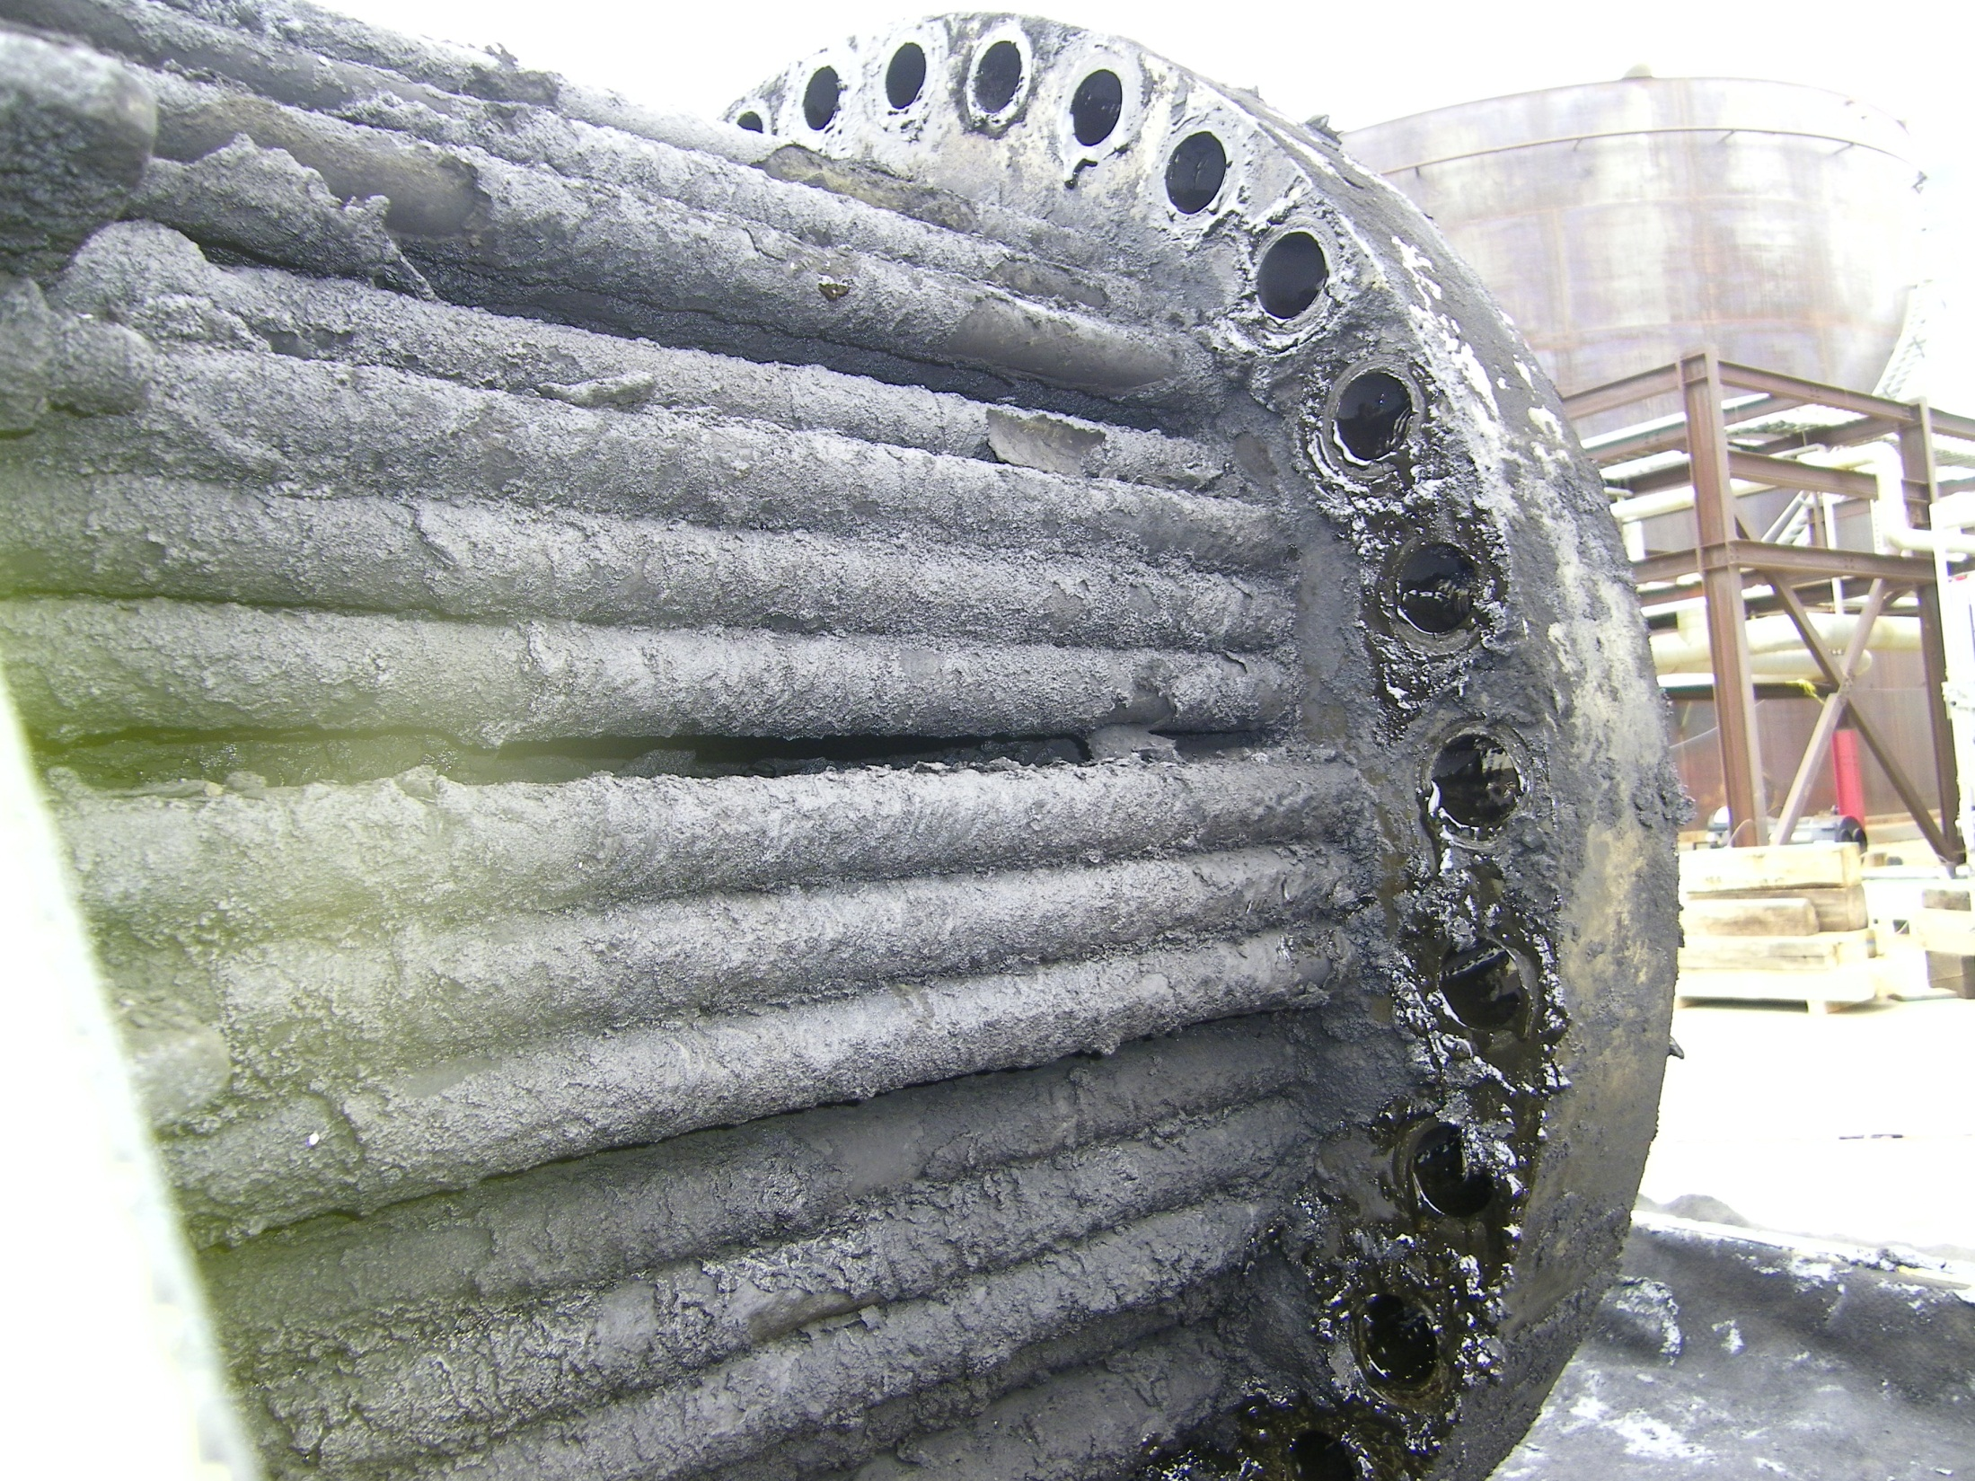
Project Scope:
44 Heat Exchangers
682 Control/Relief & Check Valves
4 Labyrinth mixers
Beyond Scope:
Several hand valves, pipe spools, hose assemblies and other non-specific items.

Slide 22
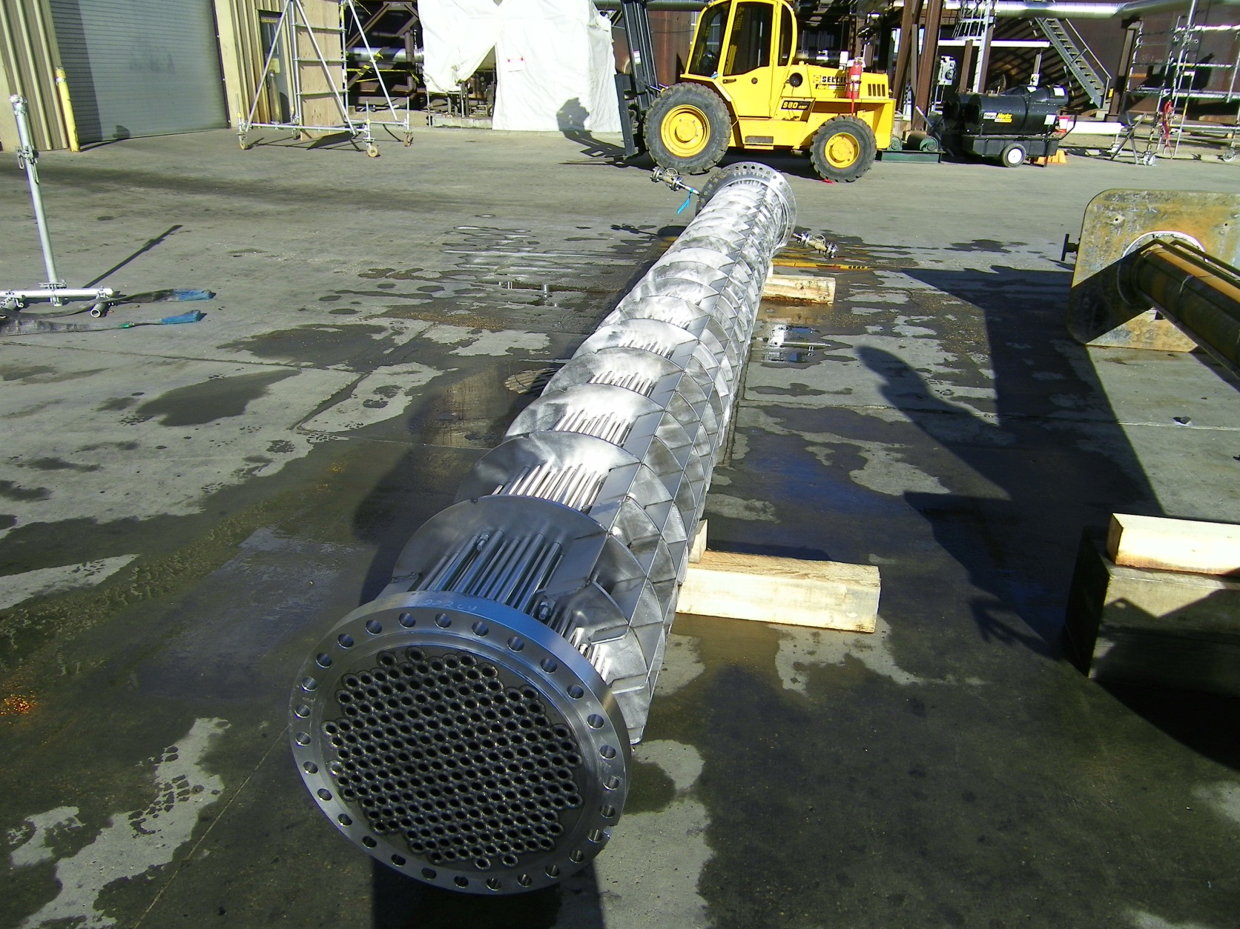
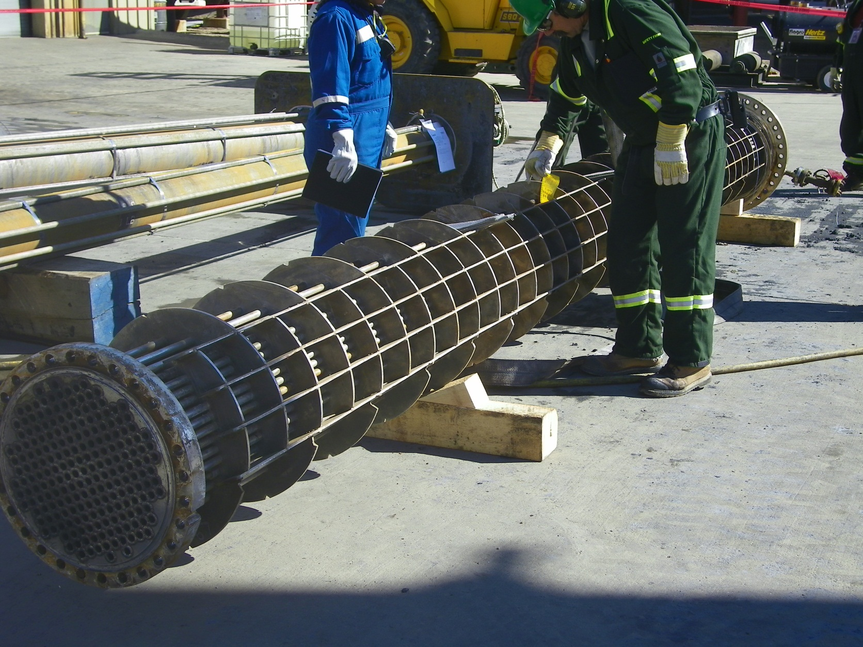

Slide 23
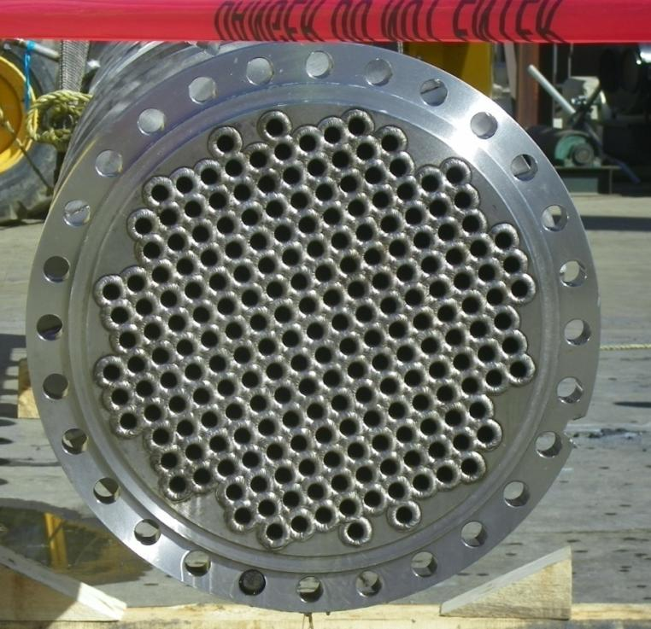
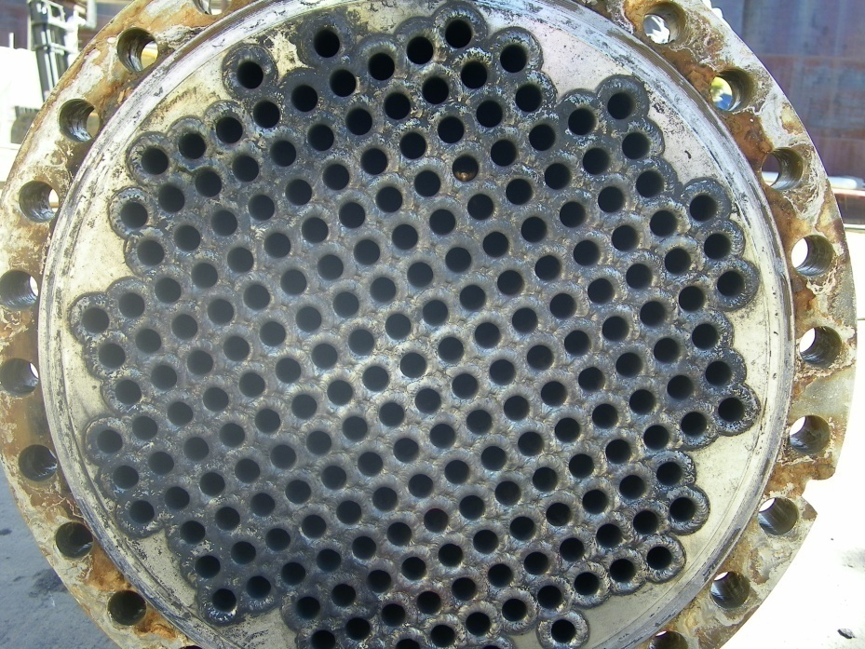
Comments from the Turnaround Manager:
“We experienced excellence results with cleaning components for offsite repair/overhaul. 3rd party companies have never seen valves as clean as the ones coming from Scotford.”
“Stainless steel bundles were cleaned better than expected and typically achieved IRIS quality. Bundles with other material composition were generally cleaned to Eddy Current quality. To achieve IRIS spec for these non-stainless, some were rinsed with a 20Kpsi & rotary lance”
Turnaround Results–

Slide 24
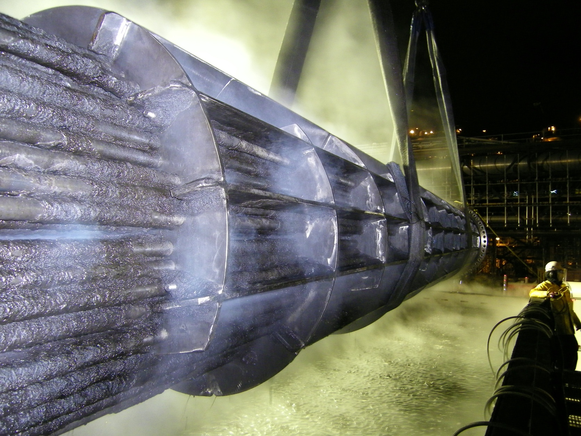
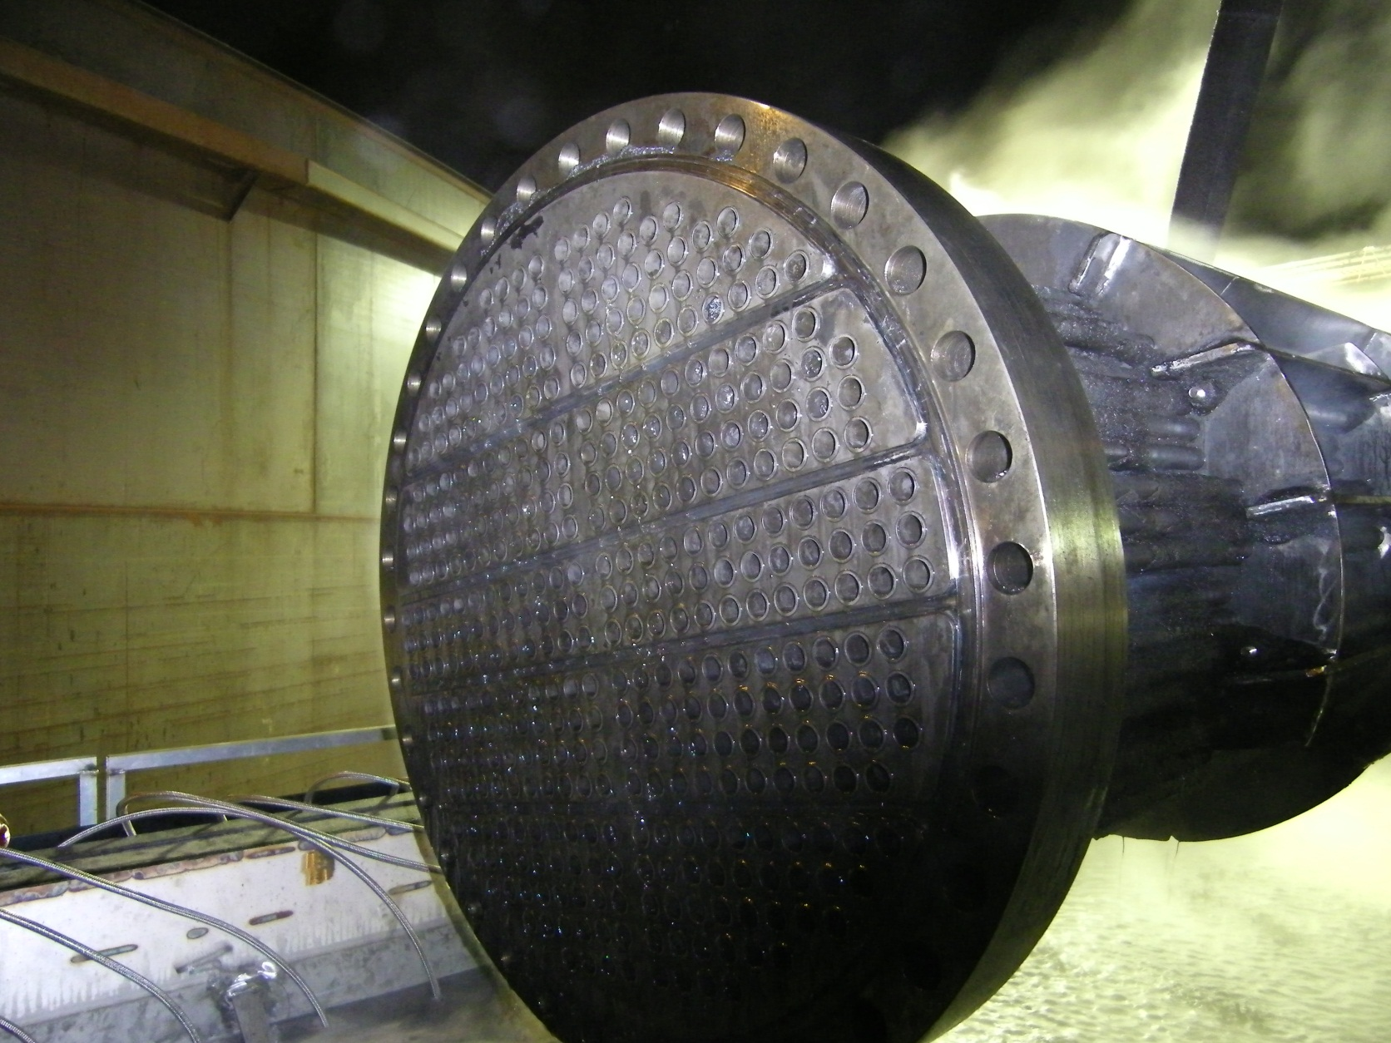
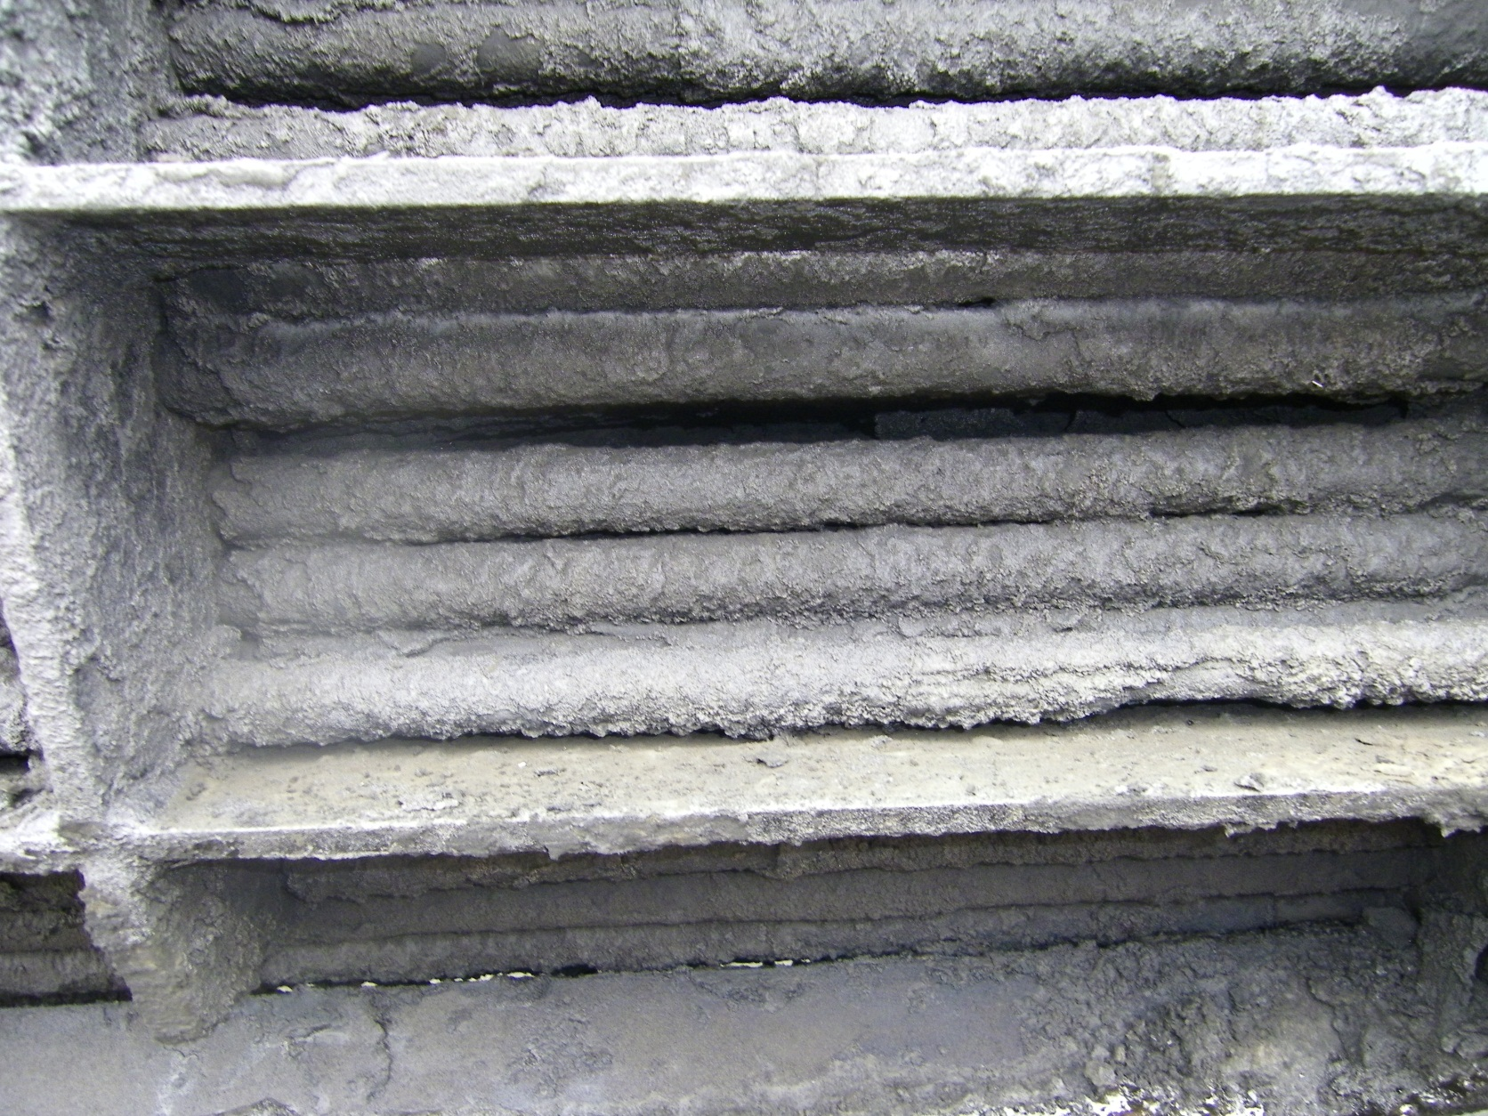
Pre-clean inspection
After 3 hours

Slide 25
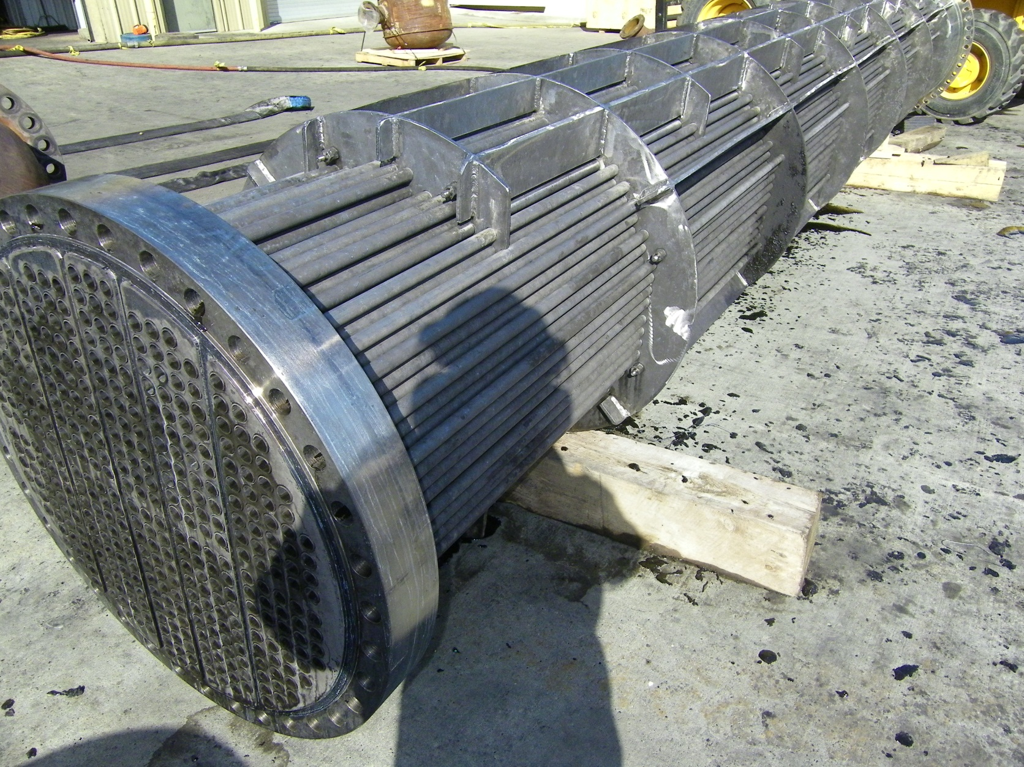
Complete for inspection
After 8 hours

Slide 26
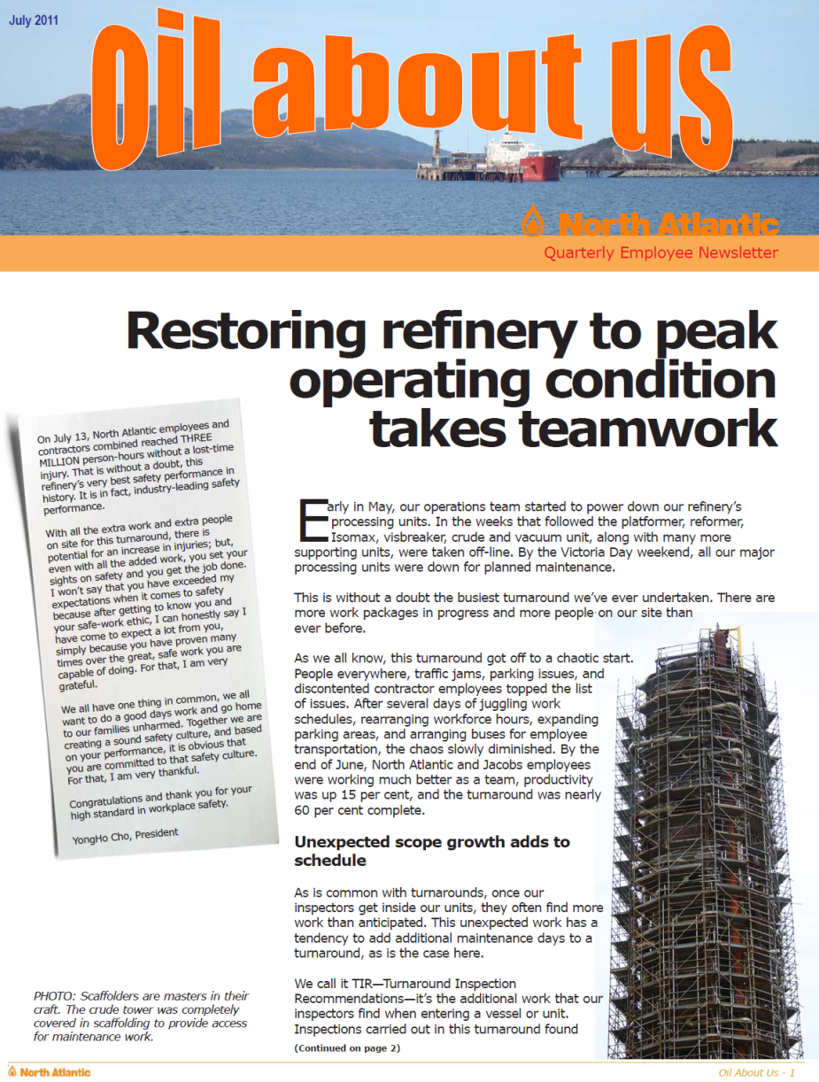
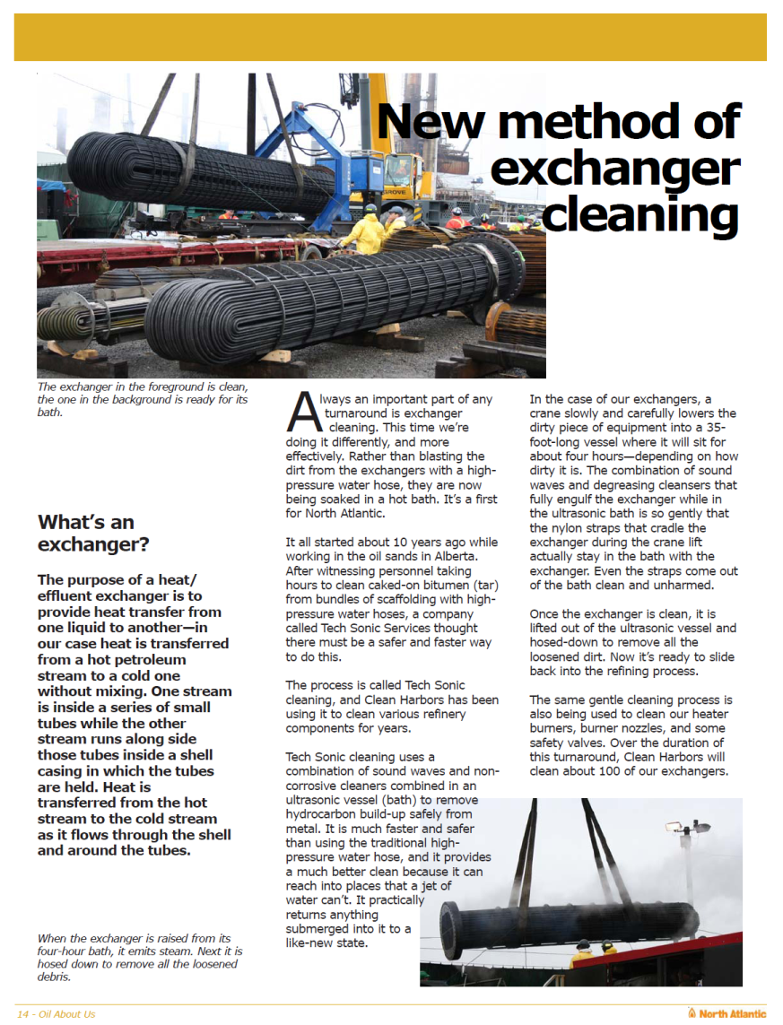
North Atlantic Refining
Maintenance Outage
Come by Chance, Newfoundland
Project Scope Completed:
115 Heat Exchangers
120 burners with nozzles,
4 towers of demister pads,
10 pressure relief valves,
various spools, pipes and
hand valves.
Equipment on site:
2- 32’ Tech Sonic Vessels
1- 8’ Tech Sonic Vessel
2 high pressure units,
1 bundle blaster,
1 x 40K rotary lance.

Slide 27
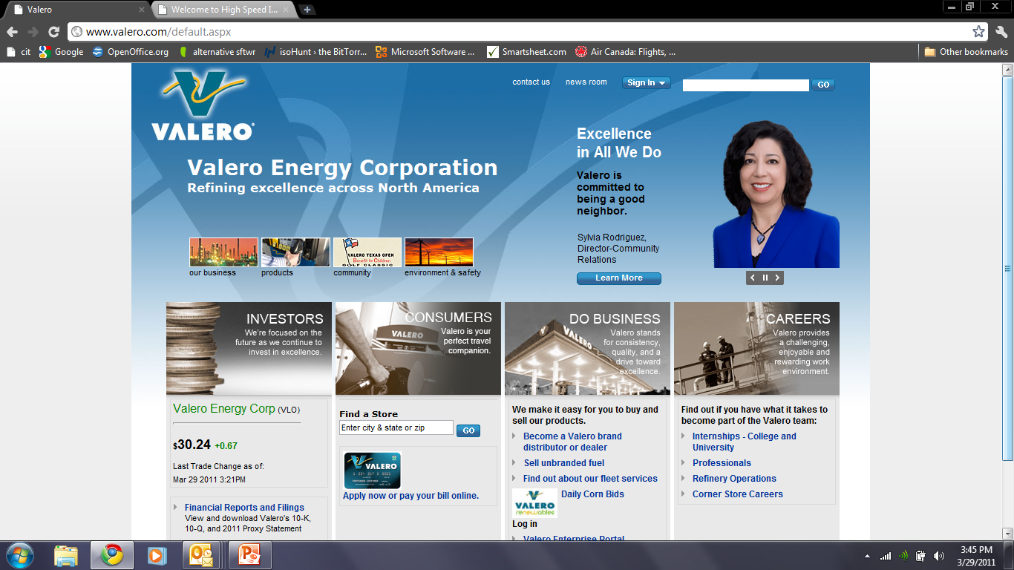
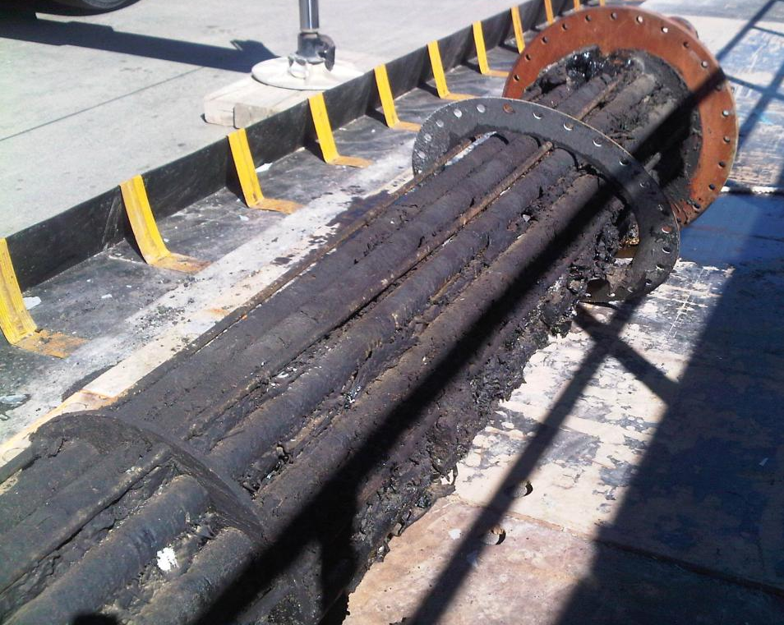
Specialty Projects:
Benicia, CA
Modified
Asphalt
Service

Slide 28
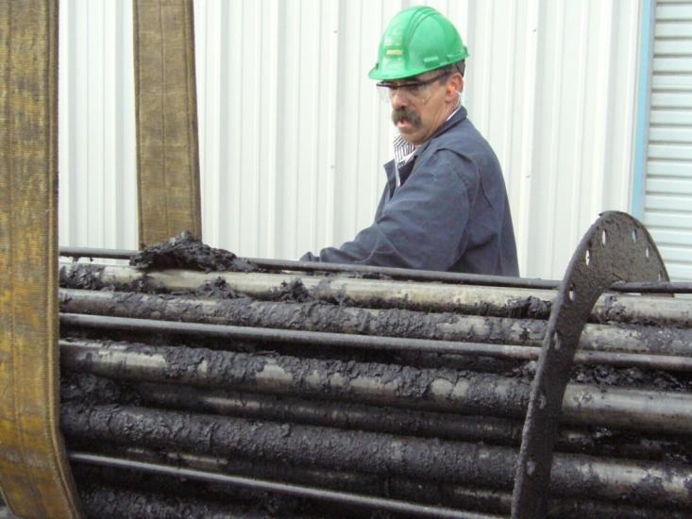
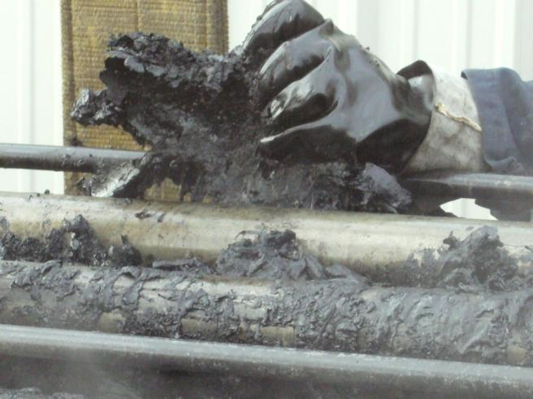
Specialty Projects:
Benicia, CA
The process has loosened the adherence of the asphalt on the tubes. The contaminants can be peeled off …
After 5 hours

Slide 29
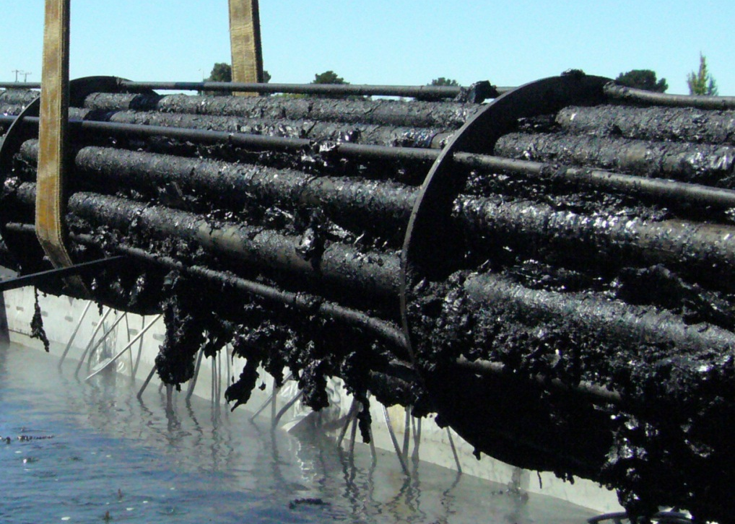
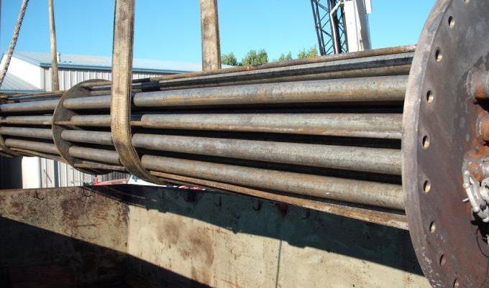
Specialty Projects:
Benicia, CA

Slide 30

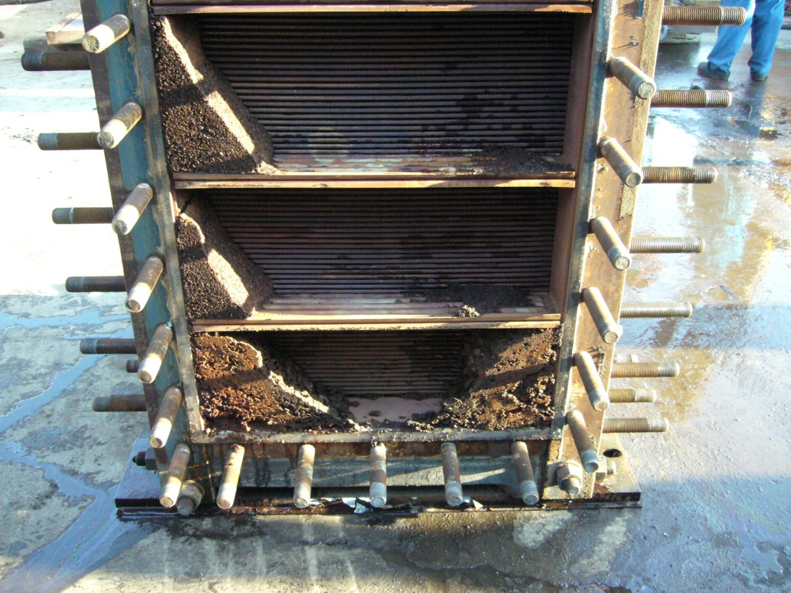
Shell
Sarnia Manufacturing Centre
Sarnia, Ontario
Alfa Laval, Compabloc®
Fixed plate and frame design of heat exchangers

Slide 31



Pre-clean condition: CC-106 units

Slide 32

Pre-clean condition: CC-106 units
The Challenge: Previous attempts using conventional cleaning methods had failed to bring production capacities into an optimal range.

Slide 33

Pre-clean condition: CC-106 units
HEN DP (psig)
Figure 1. Differential Pressure (DP) vs. Flow Capacity (%) for the 8 unit Compabloc exchanger network by year

Slide 34

Pre-clean condition: CC-106 units
Figure 2. Compabloc exchanger network DP at 70% Capacity by Year

Slide 35


Progress Cleaning: CC-106 units
After 3 hours in the Ultrasonic bath.
After 5 hours

Slide 36

Progress Cleaning: CC-106 units
After 8 hours

Slide 37


Progress Cleaning: CC-106 units
After 10 hours

Slide 38


Clean condition: CC-106 units
After 12 hours

Slide 39



Clean condition: CC-106 units
Approved for service

Slide 40

Clean condition: CC-106 units
Figure 3. Compabloc (8 unit) exchanger network DP at 70% Capacity by Year. Note: Only 4 of the 8 units were cleaned in this TA.

Slide 41


CC-106 units
Before
After

Slide 42


CC-106 units
Before
After

Slide 43
Key benefits of the process
Greater control/management of project scope.
Improved safety for all onsite personnel
Demonstrated improved performance of the cleaned components
Significantly reduces environmental impact
Reduced operational footprint
Improves cleanliness for items requiring 3rd party testing and repair.
Approved for specialty applications
Realized operational efficiencies

Slide 44
Key benefits of the process
A) Helps to manages project cleaning scope by:
Reducing overall cleaning times-
  - The OD. and ID of items are cleaned simultaneously - Basket loading and/or rigging of multiple components
Flexible cleaning platform allows many items outside of scope, to be facilitated thru the process
Inspection times are reduced
Reduces outbound time for items requiring 3rd party testing and repair (i.e. resurfacing, gasketing, corrosion evaluation)
Ultrasonic Cleaning Equipment operates 24 hours/day!

Slide 45
Key benefits of the process
B) Improved safety for all onsite personnel by:
Mitigation of risk when compared to high-pressure water use
Less high-pressure equipment required on site
Less labor required to operate ORANGE equipment
  - A single ORANGE technician can operate multiple ultrasonic baths
Fouling contaminants are held in the bath for easy removal after cleaning

Slide 46
Key benefits of the process
C) Improved performance of the cleaned components :
Statistical result and testimonial data from clients reveal that the “through-put” performance of monitored heat transfer equipment, has significantly improved.
Experimental data, reveals that (many) of these cleaned assets will perform at optimal levels for greater time intervals.

Slide 47
Key benefits of the process
D) Significantly reduces environmental impact by:
Significantly reducing water use as compared to high-pressure equipment.
Far less waste water effluent to process thru site facility.
Contaminants are held in the bath not all over the wash bays and in the sumps
Our aqueous-based chemistries are compliant with site use/ regulations and can be disposed of thru your API separators
Less diesel-powered equipment and fuel required to operate (Ultrasonic bath can operate on electricity provided at the wash bays)

Slide 48



What if the heat exchanger is too big for the bath or simply cannot be removed from the operating unit?
Can we clean this in
place?
Notes:
This Slide sequence of “before and Afters” is only visible in “Slide Show” Mode:
While the sonic immersion process is very well received and effective, there were so many more assets in similar duty that could not be cleaned, because they were too large, or it simply wasn’t economical to clean them outside the operating unit.

Slide 49

What if you could skip a cleaning interval on this entire heat train?
What if you could skip TWO INTERVALS !
Notes:
Through various industry conferences, educational symposiums and customer site, I delivered the benefits of ultrasonic immersion or tank cleaning technologies. Regardless of where I was in the World, the question was always the same. Russ, what’s next for clean-in-place?
While various clean in place methods have been around for a few years now the idea of CLEAN-IN-PROCESS, is something different altogether, and will be game changing for many industries. It allowed us to ask the question… What if you could a cleaning interval

Slide 50

Ultrasonic Scale Prevention
USP works in-line, 24/7
High frequency, low displacement vibrations
Provides greater heat transfer efficiency with energy savings.
Notes:
OK…..so The system itself uses specialized ultrasonic transducers that get physically mounted to the heat exchangers at strategic locations on the tube sheet. A series of low powered ultrasonic generators provide the resonant frequency to drive the system.
The USP solution works in-line, allowing this scale prevention technology to work 24/7 while the heat train is in full operation. It uses high frequency, low displacement vibrations to prevent mineral scale and fouling build-up, from settling within the exchangers. The result is greater heat transfer efficiency and significantly lower operational-energy costs.

Slide 51


AFTER 1 Year in operation (Power Generation Plant)
WITHOUT USP
WITH USP
Notes:
While I’m going to share some empirical data with you shortly, here is some visual evidence of the difference the system can provide.
This is an A and B side-by-side heat train that was selected for triall back in 2006.

Slide 52















russ@orangeultrasonics.com
Notes:
Here are some of the Companies currently benefiting from the USP technology. ANY QUESTIONS FROM THE GROUP TO THIS POINT ?

Slide 53



CD-6 Shell Pernis, (Rotterdam) April 2015
Heat exchangers 214 A/B have severe fouling issues.
A dedicated USP system consisting of mount on transducers and ultrasonic generators provide pulsed-power to remove existing fouling and inhibit new fouling from forming on the heat transfer surfaces.
The systems is: CE,UL and/or ATEX certified
Notes:
This next sequence of slides demonstrate the typical installation and calibration process for USP.

Slide 54


CD-6 Shell Pernis
Ultrasonic Generators

Slide 55

CD-6 Shell Pernis
Ultrasonic Transducers

Slide 56


CD-6 Shell Pernis
214 A/B
4 USP Transducers per heat exchanger.
214A
214B

Slide 57


CD-6 Shell Pernis
Frequency calibration for optimizing US cavitation and vibration
Testing

Slide 58

CD-6 Shell Pernis
Ready to go!

Slide 60
Notes:
We have other data
*Performance comparison: for OHTC
and Velocity (residue side) but as you are not dealing with CDU, not sure how relevant this would be for you.

Slide 61

UPTIME— is the key benefit of this technology. The USP system allows your processing units to continue in full operation as cleaning takes place.
Notes:
While the performance and energy savings have been significant, what we here over and over again is that when you are looking at the overall picture UPTIME is the overarching benefit of the USP technology.

Slide 62
Ultrasonic Cleaning Baths
Multiple sizes & configurations
Variable powered units for purpose-built cleaning applications
Clean-in-Process Technologies
  USP [Ultrasonic Scale Prevention]
  M³ Technology
Fouling Mitigation & Process Improvement
  M³ Technology (clamp on) apparatus with pre-selected ultrasonic power output, to match with specified outcomes
  Ultrasonic Pigging Train
Notes:
We specialize in the engineering of Purpose build ultrasonic equipment for both offline cleaning and online fouling mitigation purposes in process dependent industries.
Our focus is primarily Ultrasonically based solution sets. My experience in this space has come from my time as the Director for Global business development for Tech Sonic Services.
They were the originator of ultrasonic cleaning tanks for heat exchangers the North American market place.
I was with them from 2009 to 2013.
As I travelled the world educating audiences on the many benefits of associated with immersion based ultrasonic cleaning for heat transfer assets it became evident that the needs and desires for fouling mitigation solutions beyond many of the current offline cleaning tech’s was in fairly heavy demand.

Slide 63
Presentation By:
Russell Philion
President and Chief Technical Officer
Email: russ@orangeultrasonics.com
Direct: 416.779.8262
Notes:
While this has been a very brief presentation of the USP tech, there are other case studies/results that we can share with you when we have an NDA in place between our two companies.
Additionally, we have empirical date on cleaning results for the immersion US cleaning tanks.
To better understand how USP or the immersion technologies can best benefit Dow situations, we really need to know more about the specific processing units you are looking to make more efficient.

